Slide 1
Improving medicines adherence and reducing medicines waste: EAHSN/PrescQIPP- Strategy to develop joint working programme with the Pharmaceutical Industry
Rachel Webb
Senior Clinical Effectiveness Consultant Pfizer Ltd
Project Secondee

Slide 2
Call for Collaboration – November 2013
“This call for collaboration seeks 1-3 short term secondments from Pharmaceutical Industry organisations to collaboratively develop a framework for and between the EAHSN and the wider Pharmaceutical Industry, to kick-start a wider joint working programme with a specific focus on delivering tangible improvements around improving medicines adherence and reducing waste”.
“A major advantage of the approach .... would provide a clear, robust and concrete (at outset) framework for companies to engage with, and commit to through defining the strategic objectives, joint commitment to improvement and collaborative mind-set within a framework, this will help companies have the confidence that specific outcomes will result from their committing resources.”

Slide 3
Aims and Objectives
To develop:
A Framework for the delivery of joint working projects in partnership with multiple pharmaceutical companies ‘to improve medicines adherence and reduce medicines waste’;
Recommendations for how the framework could be applied in other EAHSN delivery areas (e.g. Clinical Study Group projects);
Programme Plans and Delivery Schedule for joint development of adherence & waste projects / campaigns;
Early stage consultation within EAHSN & Industry around tangible areas of interest;
Calls for Collaboration (via ABPI and PrescQIPP networks) to kick-start specific projects.

Slide 4
Project Secondee: Rachel Webb BPharm(Hons) MSc MRPharmS
Qualified pharmacist with 17 years of NHS experience in hospital pharmacy (formulary management, medicines information) and prescribing advice in health authorities and PCTs;
Employed by Pfizer as Clinical Effectiveness Consultant east of England;
Former NHS secondments:
Midlands and East SHA – LTC QIPP workstream (2010-12);
Midlands and East stroke review team (2012-13).

Slide 5
Project Focus:
Deliver a framework so that, a package of projects to improve medicines adherence and reduce medicines waste can then be taken forward in line with the current national themes around Medicines Optimisation.

Slide 6
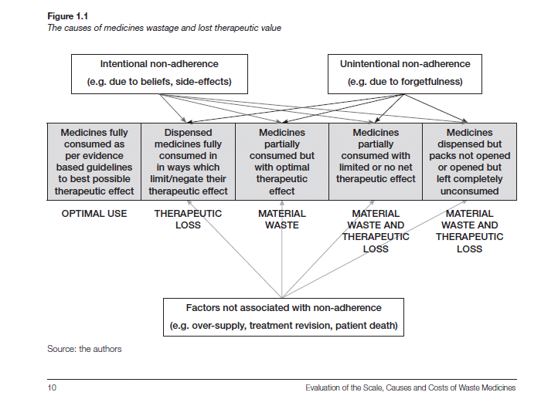
We Know Medicines Adherence is a Problem!
Ideal Situation!
Source: Evaluation of the Scale, Causes and Costs of Waste Medicines London School of Pharmacy/ York Health Economics Consortium November 2010. http://eprints.pharmacy.ac.uk/2605/ Accessed March 2014

Slide 7
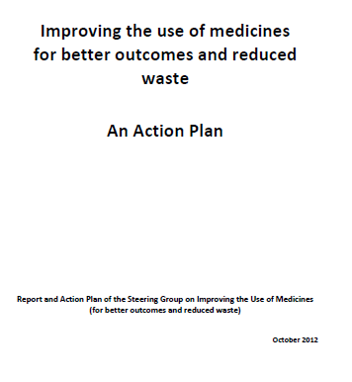
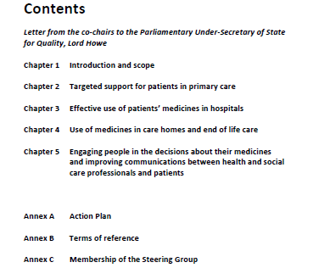
National Directives (1)
Source: Action Plan For Improving The Use Of Medicines And Reducing Waste Oct 2012 https://www.gov.uk/government/publications/action-plan-for-improving-the-use-of-medicines-and-reducing-waste Accessed February 2014

Slide 8
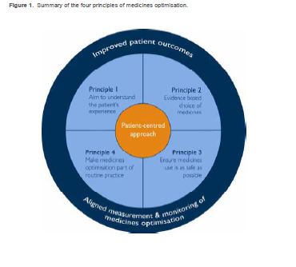
National Directives (2)
Source: Royal Pharmaceutical Society . Medicines Optimisation:
Helping patients to make the most of medicines May 2013 http://www.rpharms.com/promoting-pharmacy-pdfs/helping-patients-make-the-most-of-their-medicines.pdf Accessed February 2014

Slide 9
NICE : Medicines optimisation: the safe and effective use of medicines to enable the best possible outcomes
The Department of Health has asked NICE to develop guidance on medicines optimisation;
Need for guidance includes waste:
“The cost of waste prescription medicines in primary and community care in England is estimated to be £300 million a year, with up to half of that figure likely to be avoidable. An estimated £90 million worth of unused prescription medicines are retained in people's homes at any one time.”
Waste medicines will not be covered by final guidance.
Source: NICE Medicines Optimisation http://guidance.nice.org.uk/CG/Wave0/676 Accessed February 2014

Slide 10
Work Already Undertaken by PrescQIPP: Waste Summit July 2013
Concordance
EoE Transfer of Care Projects
M.O.A.P.A.R.S.
How could the Pharmaceutical Industry help?
Care Homes
Nutritional Waste
Optimising Safe and Appropriate Medicines Use
Managed Repeats
How do we manage these?
Publicity Campaigns
The Social Marketing Experience - “How we helped South Central – a company’s experience”
Green Bags
Green Bags & Patients Own Drugs
Secondary Care
Tracking High Cost Medicines
One Stop vs. Temp Stock – Which is Better for Returns?
SPS Waste Toolkit

Slide 11
Stakeholders
PrescQIPP and subscribers (CCG Meds Management teams);
Eastern AHSN;
ABPI and members including RIG;
Ethical Medicines Industry Group (EMIG);
CSU Medicines Management teams;
East and South East England Specialist Pharmacy Services.

Slide 12
Establishing an Agreed Framework
Identify key areas to address medicines adherence and waste:
Secondary care use of medicines;
Primary care use of medicines:
Acute/ initial generation of prescription;
Repeat prescribing;
Care homes;
Identify best practice and how applies to framework.

Slide 13
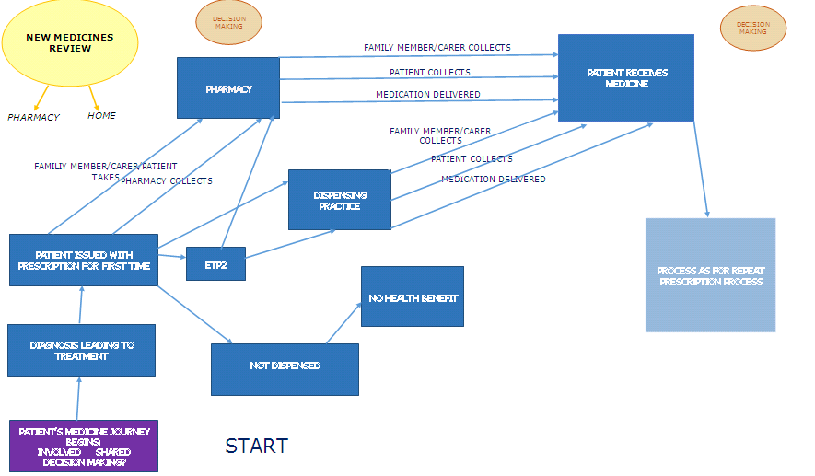
The Framework
Identify key policy areas to address medicines adherence and waste:

Slide 14
What I Need From You!
Important to involve all stakeholders in consultation process – PrescQIPP members are key!
We need your feedback!
Have we got the process right?
What does your organisation currently offer to improve Medicines Optimisation and reduce waste?
Share any best practice!

Slide 16
Contact Me!
Rachel Webb
Mobile: 07966 214527
Email: rachel.webb@prescqipp.info

Slide 17
Welcome!
Eilish Newman;
Project Manager PrescQIPP;
Co-facilitator lead workshop;
Other facilitators:
Carol Roberts;
Allison Siddorns;
Myself!

Slide 18
Workshop Task:
You have 20 minutes!
Work with your given workshop delegates to do the following:
Review the draft process map on your table;
Use the yellow post it notes to record how your would amend the process – affix to large process maps;
Use the blue post it notes to identify best practice to make the system even better and affix to large process maps;
Use the coffee break to review the work of other workshop groups and add your comments too (using the other post it pads!

