Slide 1
The Medicines Adherence and Waste Challenge
Carol Roberts
Director of Strategic Prescribing
EAHSN and PrescQIPP

Slide 2
Background: why are we here?
MAW = one of the greatest challenges to patient care and safety.
… and it’s only going to get worse without intervention.
We’re all stakeholders.
We all benefit from improved outcomes.
NHS and Industry collaboration could really make a real difference!
PATIENT
Notes:
These quotes are lifted from the Call for Collaboration and objective is to highlight the purpose of secondment and specifically what is being considered for delivery

Slide 3
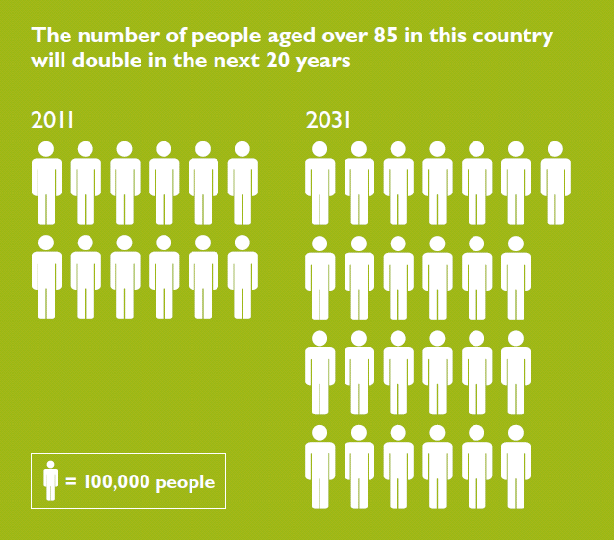

Slide 4
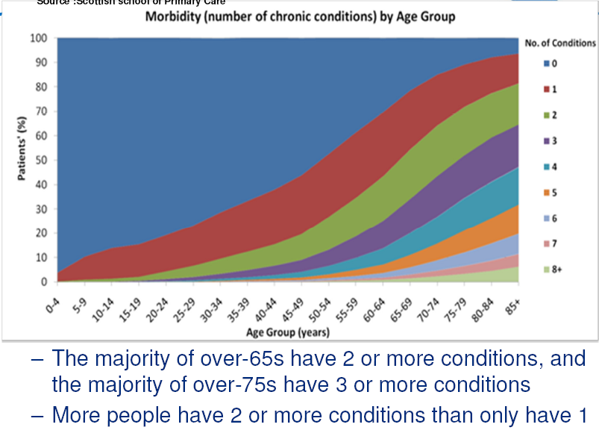
Multimorbidity is common in Scotland

Slide 5
What does this mean?
Only 18% of patients with COPD have just COPD
Only 14% of patients with Diabetes just have Diabetes
Only 5 % of patients with Dementia have just Dementia

Slide 6
Medicines utilisation in practice
Medicines - most common therapeutic intervention and biggest cost after staff
30 to 50% not taken as intended
Patients have insufficient supporting information
5 to 8% of hospital admissions due to preventable adverse effects of medicines
Medication errors across all sectors and age groups at unacceptable levels
Medicines wastage in primary care: £300M pa with £150M pa avoidable
The threat of antimicrobial resistance
Appropriate vs inappropriate Polypharmacy

Slide 7
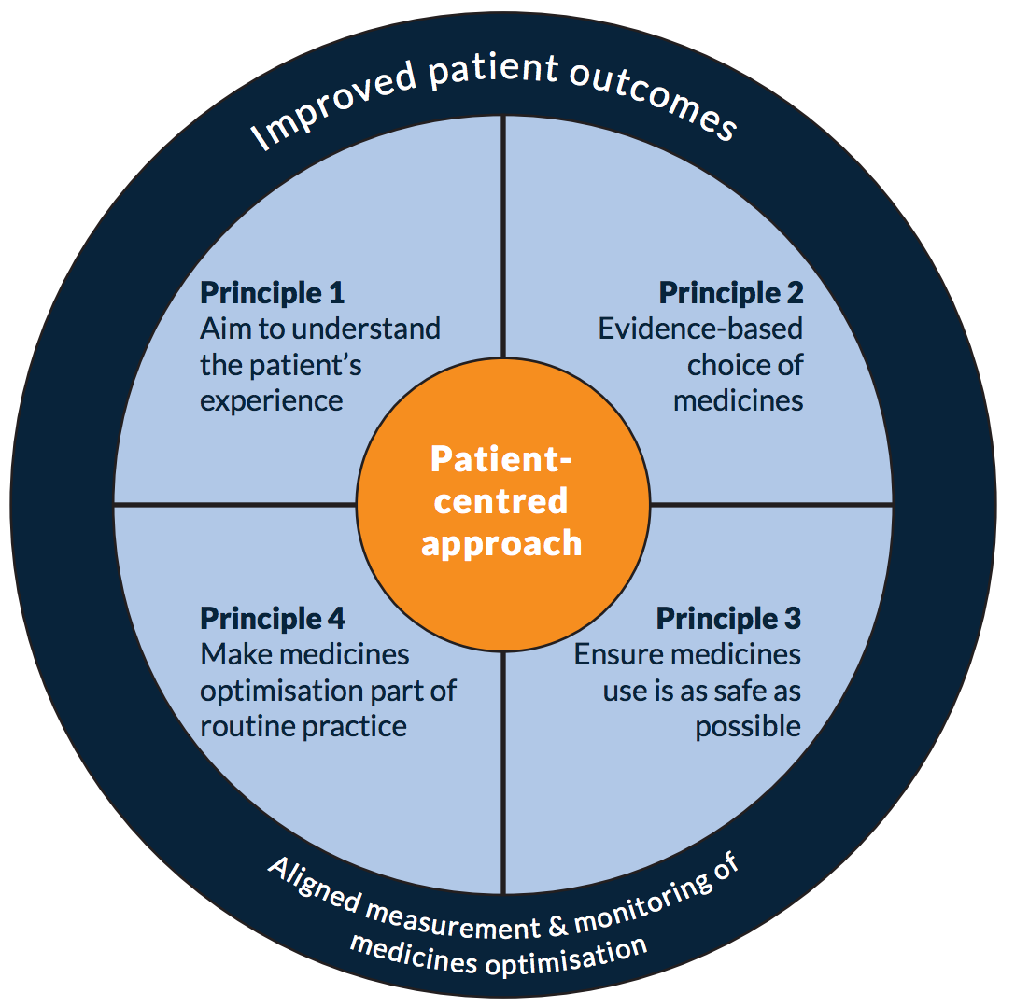
Key Driver – Medicines Optimisation

Slide 9
The causes of waste and lost therapeutic value
Source: Evaluation of the Scale, Causes and Costs of Waste Medicines London School of Pharmacy/ York Health Economics Consortium November 2010.
Notes:
We know that there are many ways that patients take medicines or not! The goal is to ensure that patients take their medicines as prescribed and receive the desired health benefit.

Slide 10
How we established a framework
Identify key areas to address:
Secondary care use of medicines;
Primary care use of medicines:
Acute/ initial generation of prescription;
Repeat prescribing;
Care homes and community care;
Review the patient’s journey;
Identify best practice and how applies to framework.
Notes:
In establishing framework really important to agree key areas to review from commissioners perspective and what is important to them but then look at what is important to patient.

Slide 11
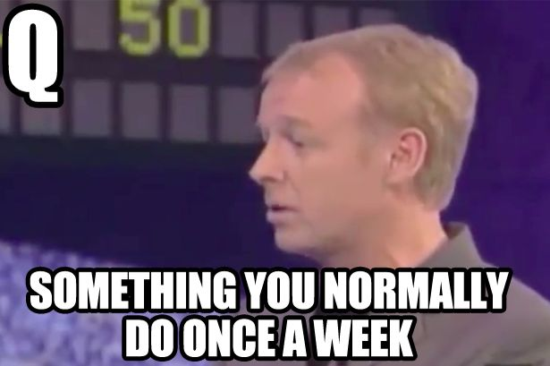
So we asked the patients for their input

Slide 12
… and so the survey said
Need more information on how medicines work and the information needs to be presented in an appropriate way;
Clarify the role of healthcare professional in medicines taking: prescriber, hospital pharmacist, community pharmacist and dispenser;
Need to improve communication between hospital and primary care;
Review place of compliance aids;
Appearance of medicines needs to be standardised;
Patients need to value medicines and know costs.

Slide 13
“Now do you understand why taking a medicine is confusing ...?

Slide 14
July – The MAW framework report
Clear methodology
A range of views
Key areas of need
Pathway maps
6 Challenges / Opportunities

Slide 15
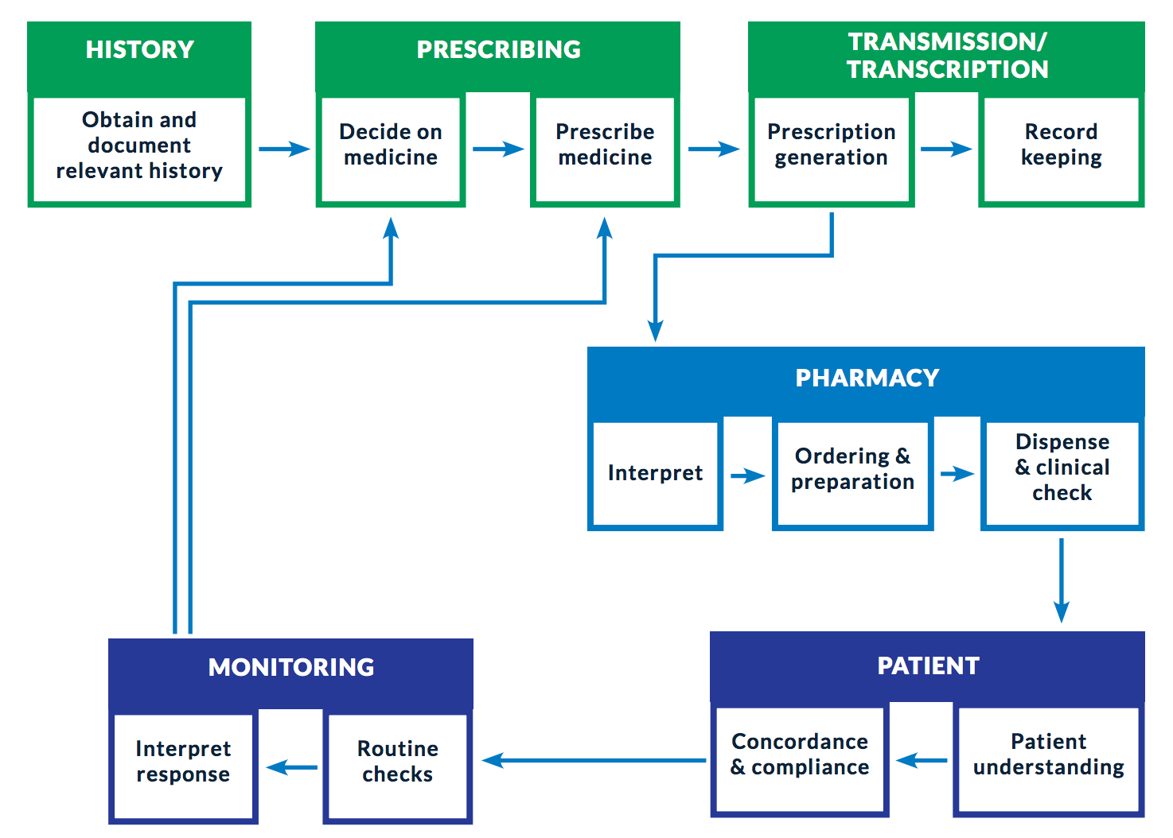
Focus on the whole pathway

Slide 16
Our 6 Challenges & Themes for MAW
A. Prescribing and the patient:
Improve patients’ understanding of medicines;
Ensure patients are completely engaged in medicines taking;
Explore opportunities to ensure effective medicine taking;
Explore opportunities with Pharma on standardisation of medicines appearance.
B. Transmission/ transcription/ supply of medicines:
Focussed pharmaceutical support to care homes;
Pharmaceutical support to extra care housing;
Evaluate impact of electronic prescribing on supply and ordering of medicines.

Slide 17
C. Communication between primary, secondary and community care:
Agree standardisation of ‘high risk patient’ and provide focussed pharmaceutical care;
Explore innovative opportunities – e.g.:
Use of green bags for medicines transmission;
Agree medicines supply in CCG contracts;
MAR charts provided on discharge for high risk pts, or receiving carer support;
More innovative use of New Medicines Service on discharge including more joined up communication relating to pharmaceutical care.
D. Effective Use of patients’ medicines in hospitals:
Explore use of dedicated admission support pharmacist;
Reduce medicines wastage in hospital:
Use unopened stickers on inhalers;
Reduce quantity and tag supply of high cost drugs to wards;
Explore use of dedicated pharmaceutical support to high risk patients on discharge.

Slide 18
E. Effective Engagement of Community Pharmacists in Pharmaceutical Review:
Explore how to make New Medicines Scheme or Medicines Use Review more effective in targeted patient groups.
Evaluate improved outcomes.
F. Explore Opportunities to ensure that patients understand the cost and value of their medicines:
Consider use of social marketing in targeted patient groups.

Slide 19
Some thoughts for the day:
So we need a step change in the way we support patients to use their medicines well.
Medicines Optimisation offers us the opportunity to collaborate with patients, the public and Pharma to get better outcomes.
We must move the focus from cost to value
Embrace innovations and new technologies

