Slide 1
Inhaler carbon footprint
Bulletin 295, v2.0
October 2021

Slide 2
Background (1)
Across England, Wales and Scotland 61.1 million inhaler items with a total carbon footprint of 1,342,923,023 kg CO₂e (NHSBSA Apr-June21) are prescribed annually
Pressurised metered dose inhalers (pMDIs) account for 71.6% of all inhaler device types prescribed in England, 68.8% in Wales and 66.6% in Scotland (NHSBSA Apr-Jun21)
Chlorofluorocarbons (CFCs) inhaler propellants contained in pMDIs were recognised as ozone depleting substances and were phased out in the UK by 1996

Slide 3
Background (2)
CFCs were replaced by ‘CFC-free’ inhalers containing hydrofluorocarbons (HFCs)
Although HFCs are not ozone depleting substances, they are powerful greenhouse gases which can contribute to global warming
Carbon emissions from inhalers have been assessed as being responsible for approximately 3% of all NHS carbon emissions
Carbon footprint impact of two puffs of a salbutamol pMDI has been estimated to be equivalent to a 500 g CO₂e
The carbon footprint of a 9-mile car journey is estimated as 2610 g CO₂e in comparison

Slide 4
Background (3)
The NHS England Long Term Plan - Reduce the carbon footprint of health and social care in line with the Climate Change Act targets of 51% by 2025
Target includes reducing the carbon emissions from inhalers
'Delivering a 'Net Zero' National Health Service' actions to be taken: optimise prescribing, substitute high carbon products for low-carbon alternatives and improve production and waste processes

Slide 5
Background (4)
Primary Care Network (PCN) Directly Enhanced Service (DES) specification for structured medication reviews and medicines optimisation makes a requirement of PCNs to “actively work with their CCG to optimise the quality of prescribing of metered dose inhalers, where a low carbon alternative may be appropriate”
NHSEI Investment and Impact Fund: 2021/22 and 2022/23 four indicators (RESP-01, RESP-02, ES-01, ES-02) to support (i) improved respiratory care and health outcomes for people with an asthma diagnosis (ii) reduce avoidable carbon emissions through encouraging choice of lower carbon inhaler alternatives, where clinically appropriate and to improve respiratory care and health outcomes for people with asthma

Slide 6
National guidance (1)
British Thoracic Society (BTS)/SIGN 2019 asthma guidelines:
  Prescribers, pharmacists and patients should be aware that there are significant differences in the global warming potential (GWP) of different pMDIs
  Inhalers with low GWP should be used when they are likely to be equally effective
  Where there is no alternative to pMDIs, lower volume HFA-134a inhalers should be used in preference to large volume or HFA-227ea inhalers

Slide 7
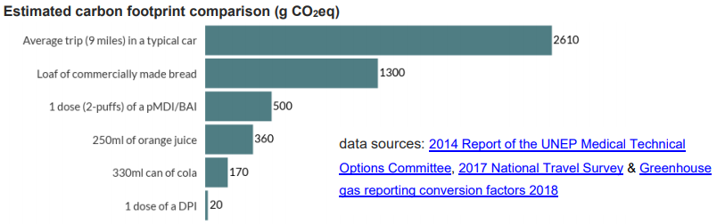
National guidance (2)
NICE inhalers for asthma patient decision aid:
  Includes environmental issues in choosing an inhaler
  Categorise inhalers as low or high carbon footprint
  People who need to use a pMDI should continue to do so
  Encourages the use of lower carbon impact inhalers
  Compares carbon footprint to everyday things

Slide 8
NICE patient decision aid: Inhalers for asthma
Encourages patients to return any used pMDIs to a pharmacy for recycling or to be disposed of in an environmentally safe way as used pMDIs still contain propellants
Refers patients to Recycle Now website https://www.recyclenow.com/what-to-do-with/inhalers-0
The Recycle Now website contains links to the recycling information for Wales, Scotland, and Northern Ireland
If every inhaler-user in the UK returned all their inhalers for one year, this could save 512,330 tonnes of CO₂e – the same as a VW Golf car being driven around the world 88,606 times

Slide 9
Inhaler carbon emissions data
Data not found in standard references e.g. BNF, SPC
Limited data available in the literature
Complete data not available from manufacturers
Variable means of recording carbon emissions by manufacturers
Product lifecycle analysis shows majority of carbon impact is from pMDI propellants
NICE patient decision aid:
  DPIs (1 dose (two puffs)): 20 g CO₂e per dose
  pMDIs (two puffs): 500 g CO₂e per dose

Slide 10
Methodology used to calculate inhaler carbon emissions
Manufacturers completed survey
Literature based estimates for non-responders/data not available
Estimates based on inhaler type (pMDI, DPI, SMI), propellant, small or large volume inhaler
Attachment 1 lists carbon footprint analysis for UK available inhalers

Slide 11
Attachment 1. Inhaler carbon footprint data
Brand name | Device type | Doses per inhaler | NHS cost per inhaler | Age licensed from | Age ranges for doses | Indicative carbon footprint /inhaler (g CO₂e)
Airomir 100 micrograms | pMDI | 200 | £1.97 | 4+ | <12, 12+ | 9720
Airomir Autohaler 100 micrograms | pMDI | 200 | £6.02 | 4+ | <12, 12+ | 9720
Easyhaler Salbutamol 100 micrograms | DPI | 200 | £3.31 | 4+ | 4-11, 12+ | 620
Easyhaler Salbutamol 200 micrograms | DPI | 200 | £6.63 | 4+ | 4-11, 12+ | 620
Salamol CFC-Free Inhaler 100 micrograms | pMDI | 200 | £1.46 | 4+ | 4-11, 12+ | 11950
Salamol Easi-Breathe 100 micrograms | pMDI | 200 | £6.30 | 4+ | 4-11, 12+ | 12080
Salbulin Novolizer 100 micrograms | DPI | 200 | £4.95 | 6+ | 6-12, 12+ | 3750
Ventolin Accuhaler 200 micrograms | DPI | 60 | £3.60 | 4+ | 4-11, 12+ | 583
Ventolin Evohaler 100 micrograms | pMDI | 200 | £1.50 | 4+ | <12, 12+ | 28262
Notes:
Attachment 1 includes data under the following headings:
Brand name
Manufacturer
Generic name
Indication: asthma, COPD or asthma and COPD
Therapeutic group
Device type
Doses per inhaler
NHS cost per inhaler
Cost/puff
Age licensed from
Age ranges for doses
MART licence?
Indicative carbon footprint /puff (gCO₂e)
Indicative carbon footprint /inhaler (gCO2e)
Number of puffs per 28 days
Indicative carbon footprint per 28 days (gCO2e)
Indicative carbon footprint per annum (gCO2e)
Low (<35gCO2e) or High (≥35gCO2e) carbon footprint per puff
Indicative cost per 28 days
Indicative cost per annum
Comments
Manufacturers or estimated from literature carbon footprint data
Propellant (from SPC)
Product AMPP SNOWMED code
Primary care rebate available (England)?
If other propellant please state
Inhaler volume
Please state how the carbon footprint per actuation (gCO2e) was calculated where this information is available
Inhaler carbon footprint attributed to raw materials API and excipients manufacturing per inhaler (including the propellant) (gCO2e)
Inhaler carbon footprint attributed to raw materials inhaler device components per inhaler (gCO2e)
Inhaler carbon footprint attributed to raw materials for packaging per inhaler (gCO2e)
Inhaler carbon footprint attributed to raw materials transportation per inhaler (gCO2e)
Carbon footprint attributed to energy and water consumption per inhaler (gCO2e)
Carbon footprint attributed to manufacturing waste per inhaler (gCO2e)
Carbon footprint attributed to HF leaks and air emissions per inhaler (gCO2e)
Carbon footprint attributed to distribution and transportation per inhaler (gCO2e)
Carbon footprint attributed to user phase per inhaler (gCO2e)
Carbon footprint attributed to end of life per inhaler (gCO2e)
Carbon footprint attributed to other carbon emission data held per inhaler (gCO2e)
Do you have plans to change to HFA152a propellant or alternative lower GWP value propellant?
When do you plan to introduce lower GWP propellants in your inhalers?
Further information on the carbon footprint of this product
For comparison, PrescQIPP Hot Topics Resource prior estimates for the indicative carbon footprint /puff (gCO2e)
Midpoint value^{8,10}

Slide 12
Strategies to support a reduction in inhaler carbon emissions

Slide 13
Delivering a ‘Net Zero’ NHS
Optimise prescribing
Substitute high carbon products for low-carbon alternatives
Improvements in production and waste processes

Slide 14
Optimise prescribing
Get or maintain good control of asthma and COPD through reviewing patients regularly and treating in line with NICE asthma and COPD treatment pathways
Agree local respiratory pathways and medicines formulary choices which take into account inhaler carbon footprints
Demonstrate and check inhaler technique
Identify and reduce SABA overuse
Change to combination inhalers where clinically appropriate
Prescribers discussing, with individual patients, lower carbon footprint inhalers during patient reviews or when a change in treatment is clinically necessary

Slide 15
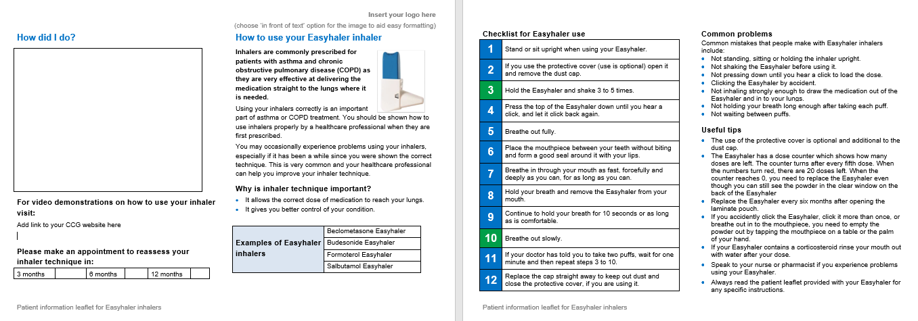
Inhaler technique assessment videos and leaflets
Insert image and link to videos / leaflets

Slide 16
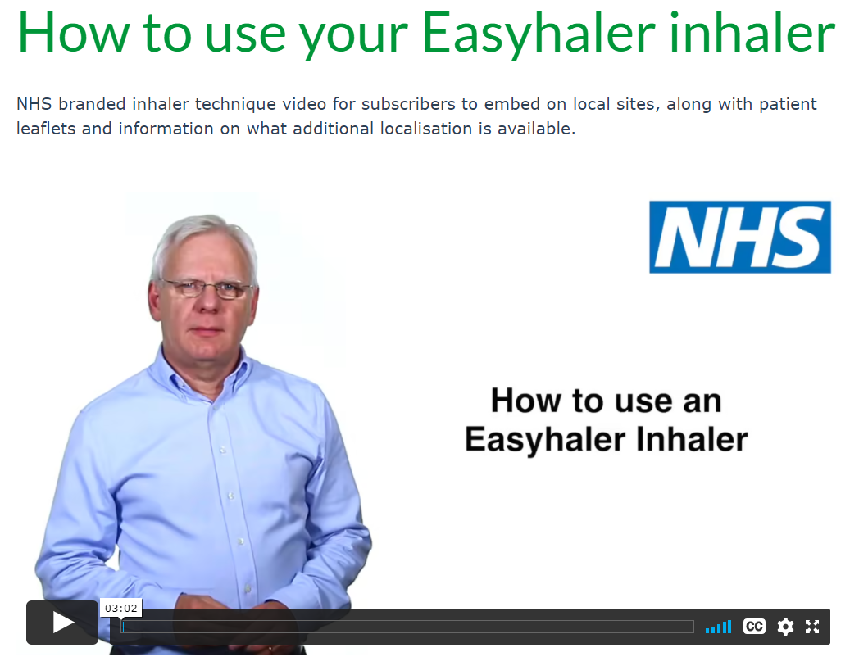

Inhaler technique assessment videos and leaflets
QR code

Slide 17
Reducing the environmental impact of inhalers in respiratory care through optimised prescribing (1)
What to do | How to do it
Improve asthma control and reduce use of SABA reliever inhalers | Encourage regular preventer treatment by every means possible, empowering patients by helping them understand their condition and how their treatments work Ensure that health professionals understand the dose ranges and relative potencies of inhaled corticosteroids Undertake an audit of very high SABA use in patients with asthma and review those flagged as very high users.
Improve asthma control in patients on low dose of ICS as maintenance therapy | In adults (aged ≥17), offer a LTRA in addition to low dose ICS as maintenance therapy and review in 4 to 8 weeks
Improve COPD control and reduce use of SABA reliever inhalers | Smoking cessation, exercise promotion and pulmonary rehabilitation, flu immunisation, regular long acting bronchodilators
Use combination inhalers for patient convenience and to support treatment adherence | Patients on more than one type of single inhalers (ICS, LABA, LAMA) changed, where clinically suitable, to combination inhalers

Slide 18
Reducing the environmental impact of inhalers in respiratory care through optimised prescribing (2)
What to do | How to do it
Promote effective self-management | Written personal action plans
Ensure all inhalers are used with correct technique for greater effectiveness | Know how to teach this and do it Encourage use of online video tutorials
Make optimal use of spacers to increase clinical effectiveness of pMDIs where these are clinically appropriate | Consider in patient using pMDIs to use spacers to aid inhalation: increases lung deposition and reduces oral deposition of drug
Ensure patients have a pMDI and spacer emergency treatment pack for self-management of exacerbations, especially if using DPIs for regular treatment | Provide emergency treatment packs with clear simple pictorial instructions for their use

Slide 19
Support prescribers to start new patients on or switch existing patients to lower carbon inhaler alternatives (1)
Prescriber education on lowering the inhaler carbon footprint
Providing practice level inhaler carbon footprint prescribing data
Producing local respiratory prescribing guidelines which include lower carbon footprint inhalers and how to optimise prescribing
Ensuring lower carbon footprint inhaler options are included in medicines formularies

Slide 20
Support prescribers to start new patients on or switch existing patients to lower carbon inhaler alternatives (2)
Providing examples of locally preferred switches from high to lower carbon footprint inhalers
Undertaking audits to identify respiratory patients suitable for review to improve clinical outcomes and reduce the inhaler carbon footprint
Providing patient information resources to explain the change to low carbon footprint inhalers
Ensuring stock availability of any alternative inhaler switches locally recommended through discussions with pharmacies, suppliers and/ or manufacturers

Slide 21
Reduce the environmental impact of inhaler waste
Encourage patients to return their used or unwanted inhalers to a pharmacy for either recycling where available or environmentally safe disposal
Encourage patients to look after their inhalers and to not over-order
Ensure that patients know how to tell when their inhaler is empty
Increase use of re-usable inhalers

Slide 22
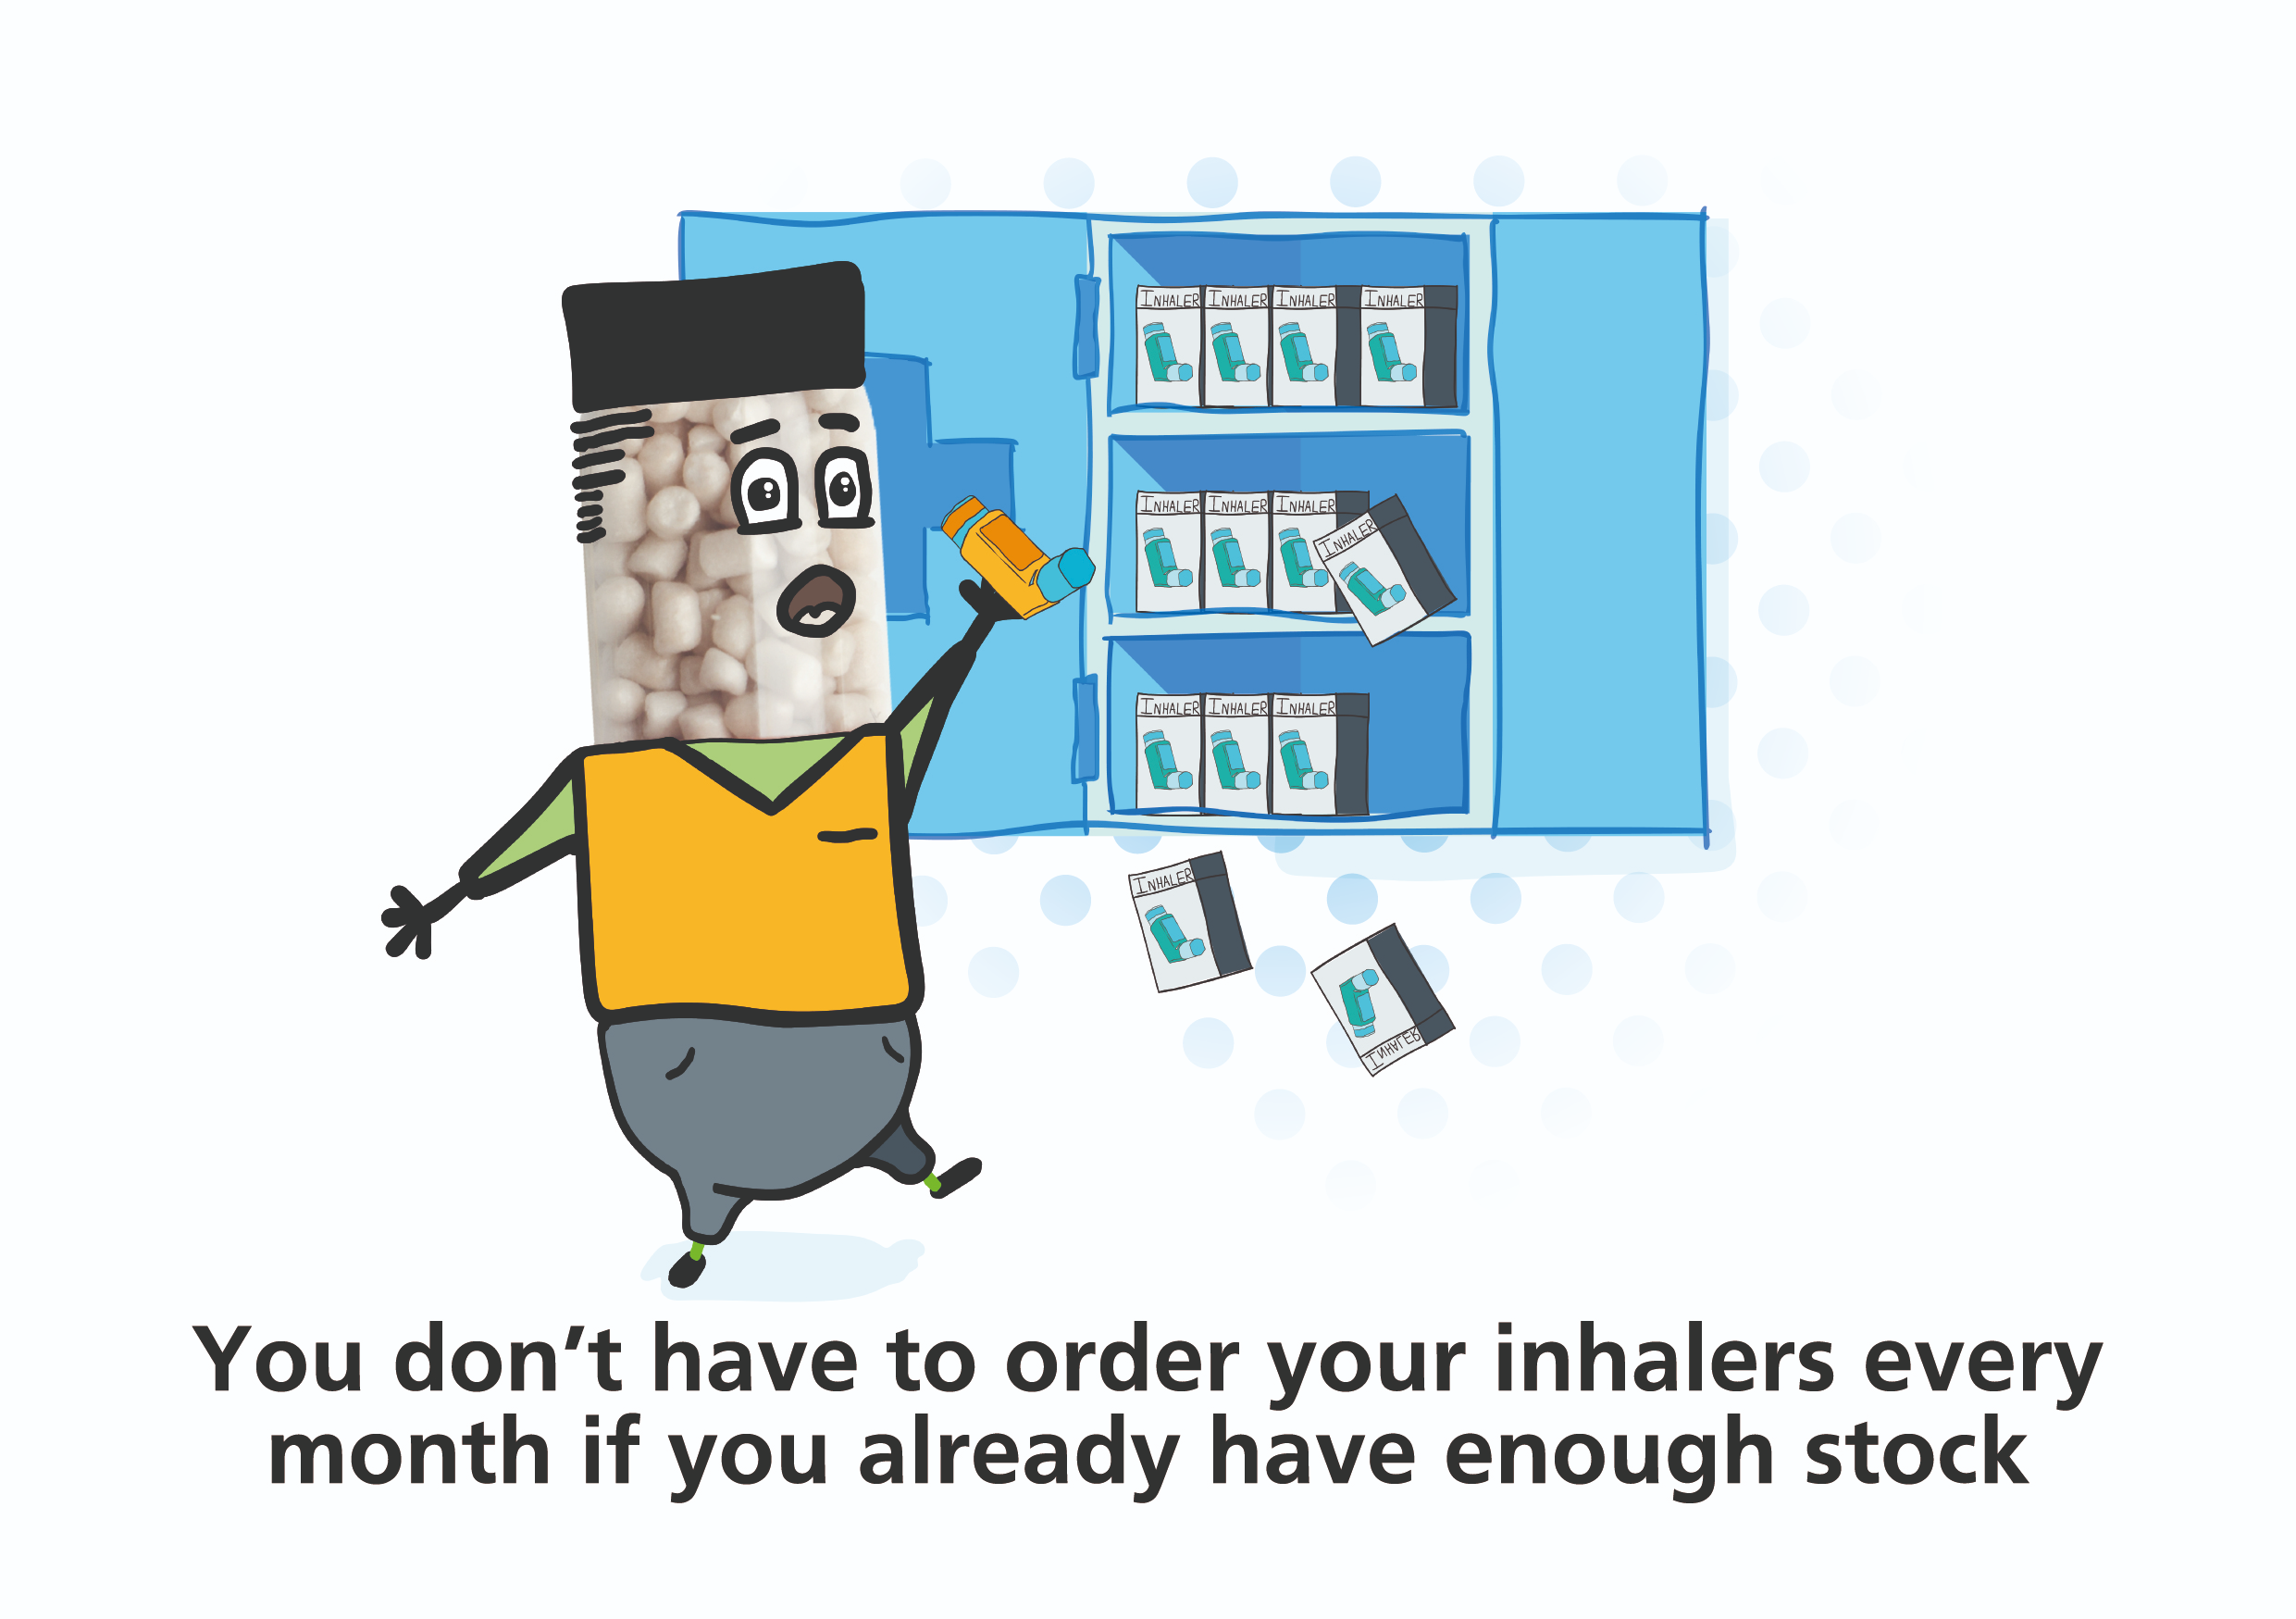
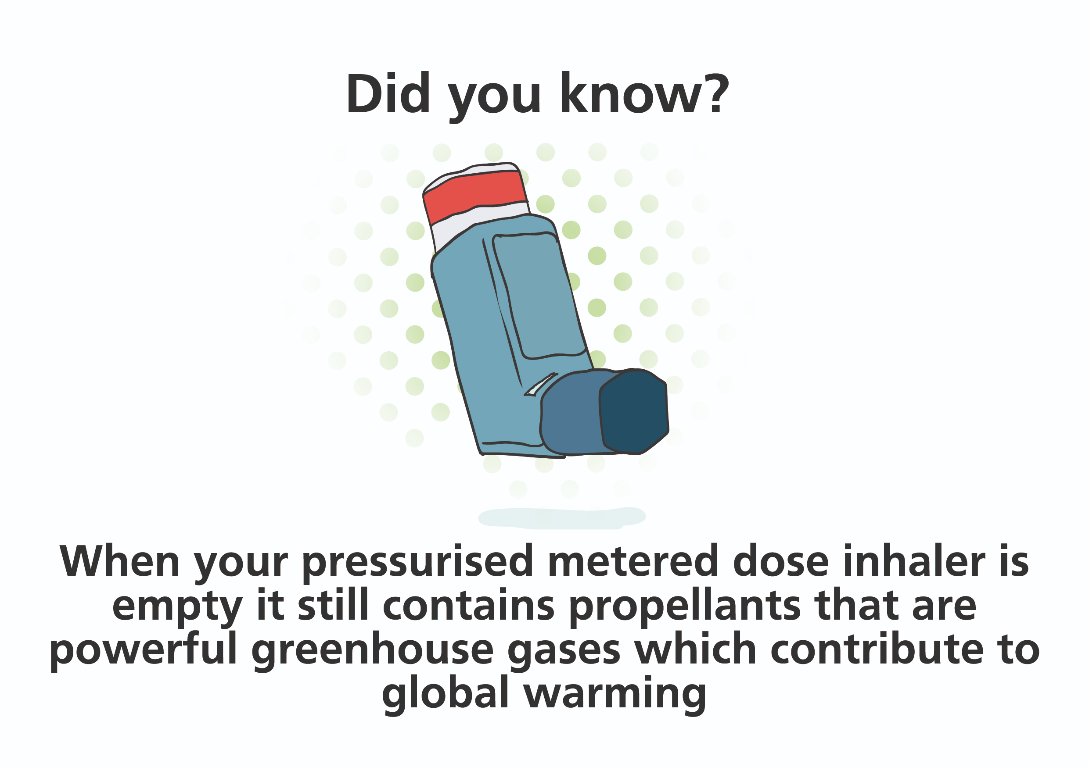
PrescQIPP campaign materials to prevent over ordering and promote environmentally safe disposal

Slide 23

Reducing the environmental impact of inhalers in respiratory care
What to do | How to do it
Ensure pMDIs are not discarded before they are empty | Teach patients how to recognise correctly when inhalers are empty Encourage wider use of dose counters on pMDIs
Promote inhaler recycling | Encourage local pharmacies to take part in any local inhaler recycling schemes or develop and promote use of inhaler recycling schemes to reduce waste of plastic, metal and propellant Educate patients about inhaler recycling and disposal as part of their inhaler technique check
Optimise the use of re-usable inhalers | Prescribe refill cartridges with re-usable inhalers when prescribing Respimat® inhalers

Slide 24
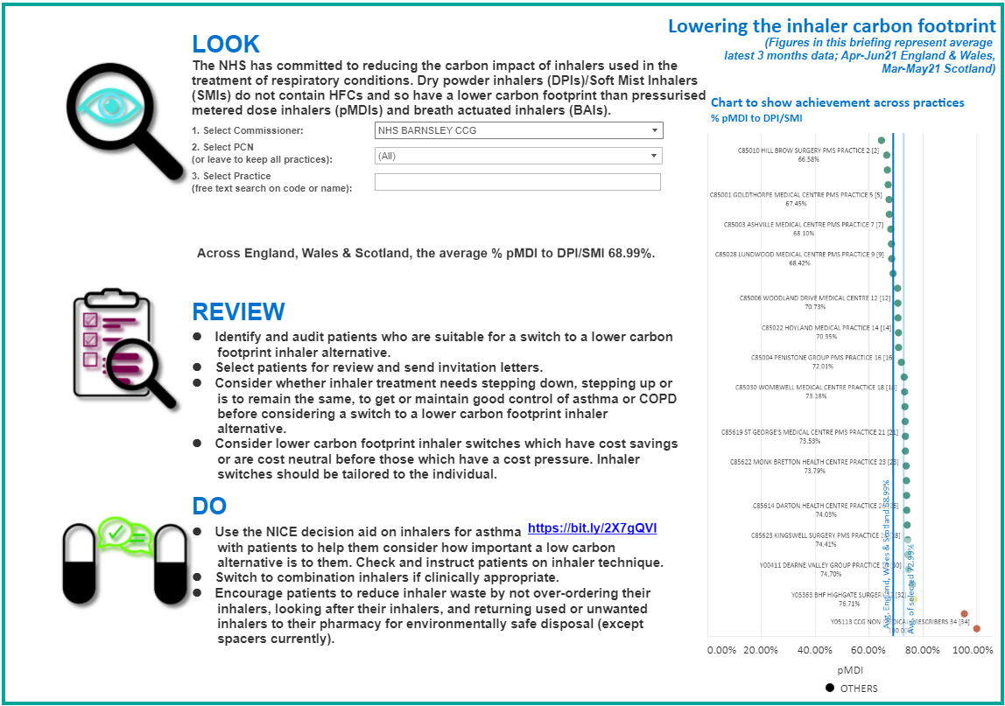
Prescribing data
Insert localised InfoBrief from PrescQIPP inhaler carbon footprint visual data pack

Slide 25
Costs and savings (1)
Across England, Wales and Scotland 61.1 million inhaler items are prescribed annually with a total carbon footprint of 1,342,923,023 kg CO₂e (NHSBSA Apr-June21)
The PrescQIPP lowering the inhaler carbon footprint data tool and visual data pack allows users to view their local prescribing data and how this compares to the national average. The impact of any inhaler switches being considered in terms of indicative carbon footprint and cost impact can be reviewed

Slide 26
Costs and savings (2)
Across England and Wales, switching 25% of Ventolin pMDIs to Salamol pMDI would produce a 12 months carbon footprint saving of 106,699,451 kg CO₂e and produce a 12 months cost saving of £261,647 [NHSBSA Jun-Apr21]
Switching 25% of Fostair 100/6 pMDI to Fostair NEXThaler 100/6 would be cost neutral and produce a 12 months carbon footprint saving of 14,442,353 kg CO₂e across England and Wales[NHSBSA Jun-Apr21]
[Insert local switch choices and carbon footprint savings]

Slide 27
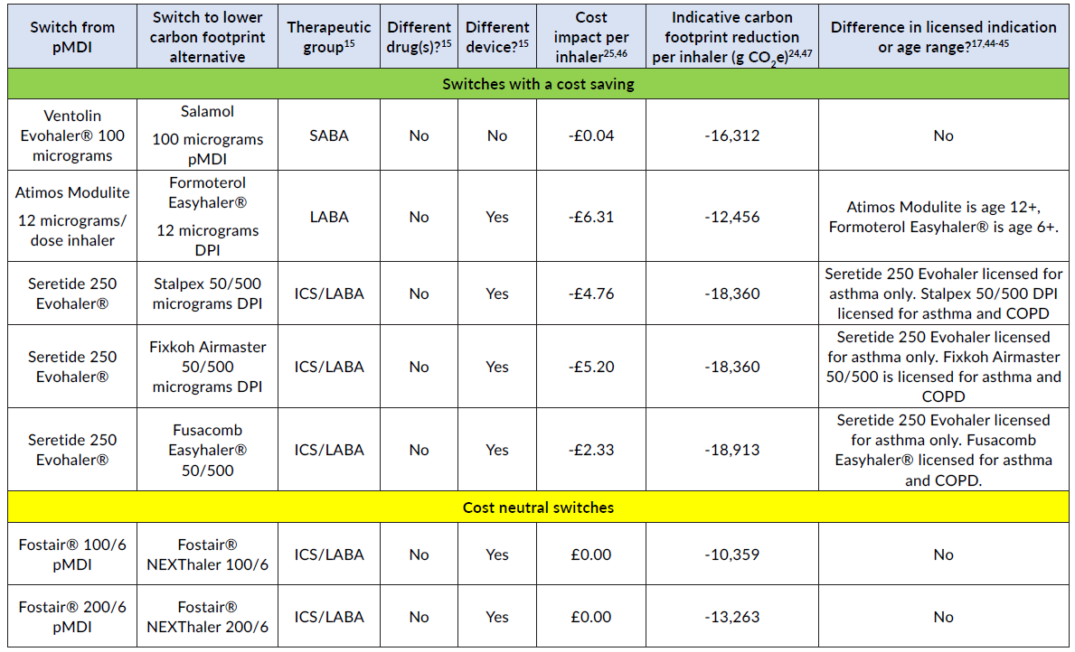
Less complex inhaler switches to reduce use of pMDIs

Slide 28
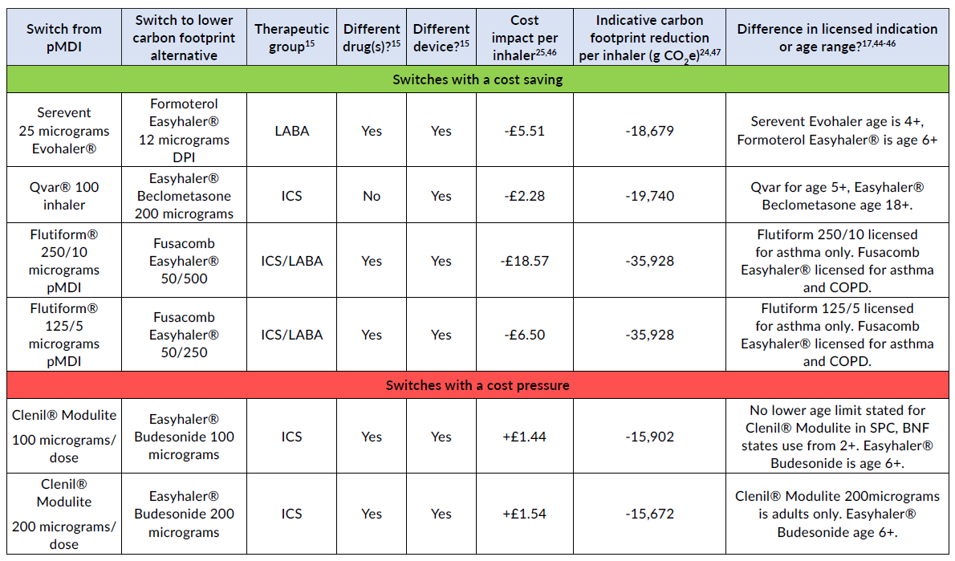
More clinically complex inhaler switches to reduce use of pMDIs

Slide 29
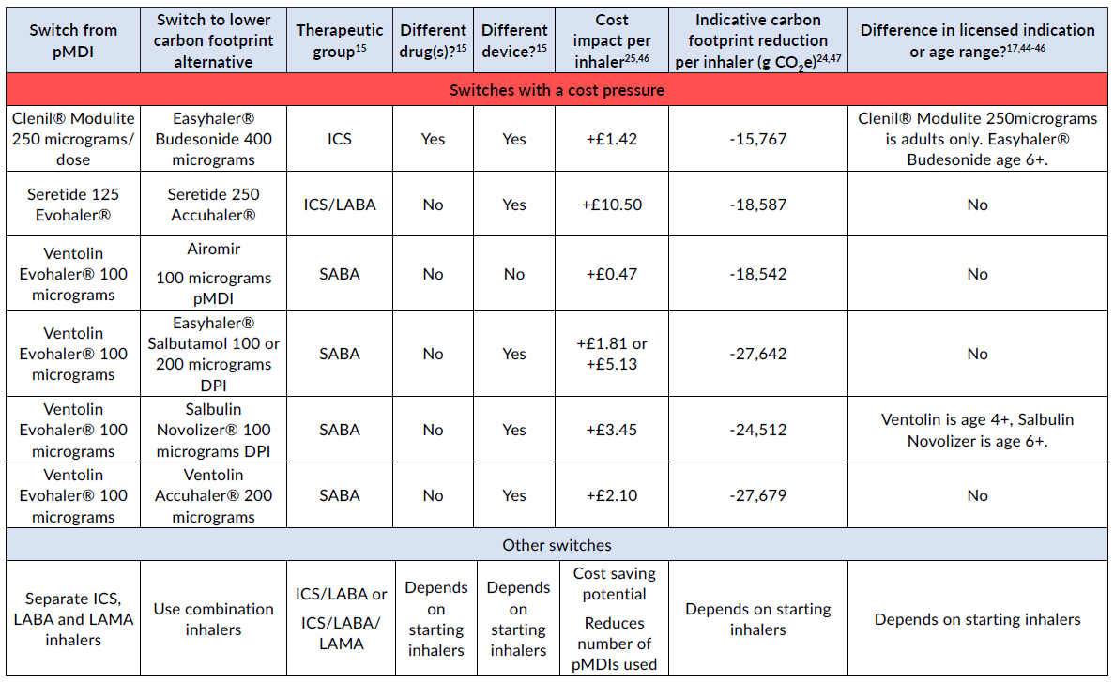
More clinically complex inhaler switches to reduce use of pMDIs

Slide 30
Recommendations (1)
Determine how local prescribing data on the inhaler carbon footprint compares to the national average and identify where local improvements can be made using the PrescQIPP inhaler carbon footprint data tool and visual data pack
Agree, through an appropriate group such as the Area Prescribing Committee, a range of strategies to support the NHS commitment to lower the inhaler carbon footprint

Slide 31
Recommendations (2)
Agree medicines optimisation strategies to lower the inhaler carbon footprint which optimise prescribing by:
  Getting or maintaining good control of asthma and COPD through reviewing patients regularly and treating in line with NICE asthma and COPD treatment pathways.
  Agreeing local respiratory pathways and medicines formulary choices which take into account lower inhaler carbon footprint options
  Demonstrating and checking inhaler technique
  Identifying and reducing short-acting beta-2 agonist (SABA) overuse
  Changing to combination inhalers where clinically appropriate
  Prescribers discussing, with individual patients, lower carbon footprint inhalers during patient reviews or when a change in treatment is clinically necessary

Slide 32
Recommendations (3)
Support prescribers to start new patients on or switch existing patients to lower carbon inhaler alternatives. Examples of support include:
Prescriber education on lowering the inhaler carbon footprint
Providing practice level inhaler carbon footprint prescribing data
Producing local respiratory prescribing guidelines which include lower carbon footprint inhalers and how to optimise prescribing
Ensuring lower carbon footprint inhaler options are included in medicines formularies

Slide 33
Recommendations (4)
Support prescribers to start new patients on or switch existing patients to lower carbon inhaler alternatives. Examples of support include:
Providing examples of locally preferred switches from high to lower carbon footprint inhalers
Undertaking audits to identify respiratory patients suitable for review to improve clinical outcomes and reduce the inhaler carbon footprint
Providing patient information resources to explain the change to low carbon footprint inhalers
Ensuring stock availability of any alternative inhaler switches locally recommended through discussions with pharmacies, suppliers and/ or manufacturers

Slide 34
Recommendations (5)
Reduce waste by:
  Encouraging patients to return their used or unwanted inhalers to a pharmacy for either recycling where available or environmentally safe disposal
  Encouraging patients to look after their inhalers and to not over-order
  Ensuring that patients know how to tell when their inhaler is empty
  Increasing the use of re-usable inhalers

Slide 35
Summary
The NHS has committed to reducing the carbon footprint of health and social care in line with the Climate Change Act targets of 51% by 2025
This target includes reducing the carbon emissions from inhalers
A range of strategies can support achievement of this target including optimising prescribing, switching to lower carbon footprint alternatives where clinically appropriate, and reducing inhaler waste
Organisations should agree strategies for lowering the local inhaler carbon footprint through a relevant group such as the local Area Prescribing Committee

Slide 36
Resources available
Bulletin
Briefing
Inhaler carbon footprint visual data pack and Info Brief
Attachment 1. Inhaler carbon footprint data table
Inhaler carbon footprint data tool
Audit template -Inhaler clinical reviews to improve patient outcomes and reduce the inhaler carbon footprint
GP clinical system searches – high impact switches
Patient information
Infographic poster

Slide 37
Any questions?
Thank you

