Slide 1
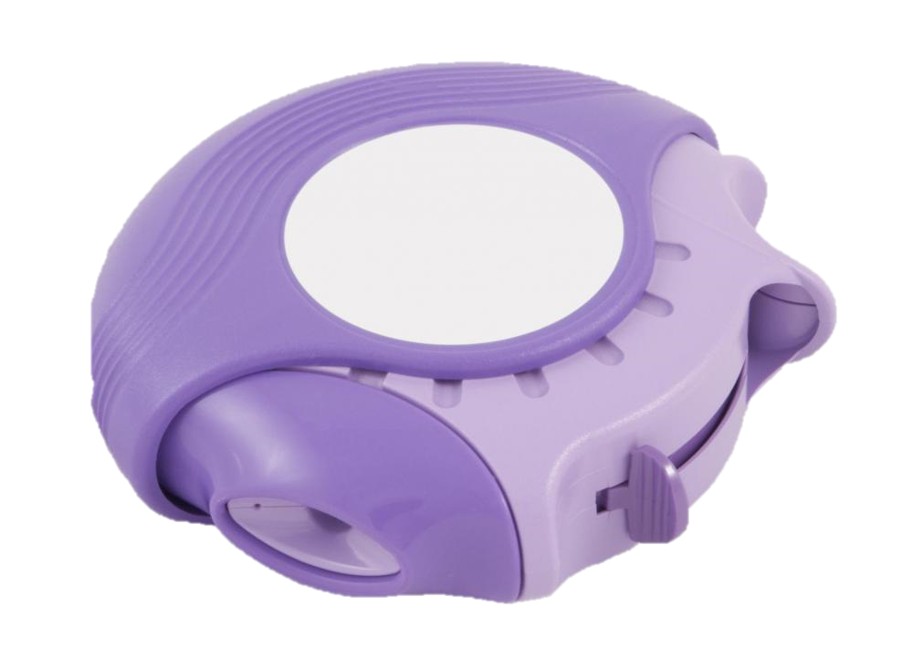
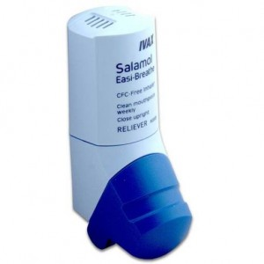
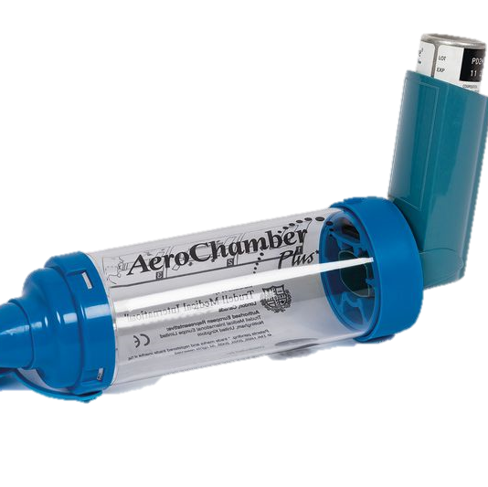
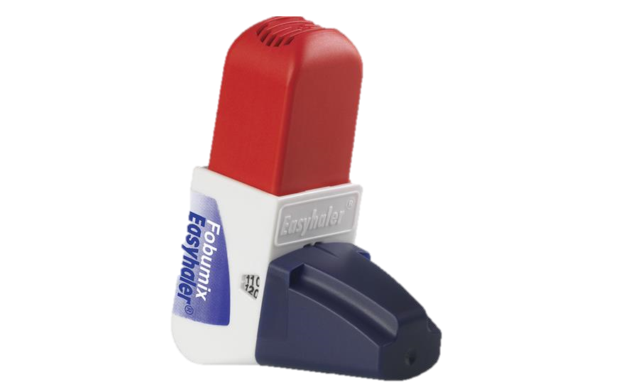

Inhalers and the environment
Frances Mortimer, Centre for Sustainable Healthcare
Kathleen Leedham-Green, Imperial College London
Aarti Bansal, GP and founder @GreenerPractice

Slide 2
Session outline
Presentation
Dr Frances Mortimer
Consolidation
Dr Kay Leedham-Green
Optimising respiratory care
Self-test quiz
Q&A
Case studies
Discussion
Inhalers and the environment
Dr Aarti Bansal will address your questions (keep them coming in the chat!)

Slide 3
High-quality & low-carbon asthma care: a green challenge and a golden opportunity!
Right diagnosis
Patients on inhalers without a diagnosis!
Right drug
Address over-reliance on relievers (SABA/LABA), under-use of preventers (ICS)
Right device
Right disposal
Dry powder inhalers or soft mist inhalers where clinically appropriate
Return all aerosol inhalers for incineration / recycling
If aerosol (pMDI) inhalers are needed, then choose brand and regime to minimise carbon footprint
Better care,
greener care
Pollution, smoke, housing…
Optimise local return schemes
Severe asthma vs suboptimal inhaler technique
Optimise according to guidelines e.g. consider MART (combined maintenance and reliever therapy)
Optimise drug delivery / inhaler technique
Notes:
This presentation focuses primarily on inhalers and the environment, but we will also touch on holistic optimisation of care which is also good for the environment.

Slide 4

NHS commitment to carbon neutrality
“2020 has been dominated by Covid-19 and is the most pressing health emergency facing us. But undoubtedly climate change poses the most profound long-term threat to the health of the nation.
It is not enough for the NHS to treat the problems caused by air pollution and climate change – from asthma to heart attacks and strokes – we need to play our part in tackling them at source.”
Sir Simon Stevens: CEO NHS England, October 2020
Notes:
Sir Simon Stevens is the CEO of NHS England. He positions climate change as a far greater threat to health than COVID-19 and has committed to tackling it at source through a Net Zero strategy.

Slide 5
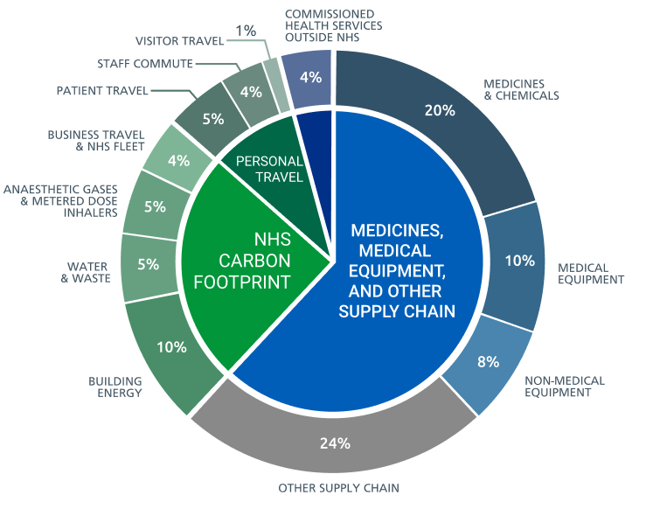

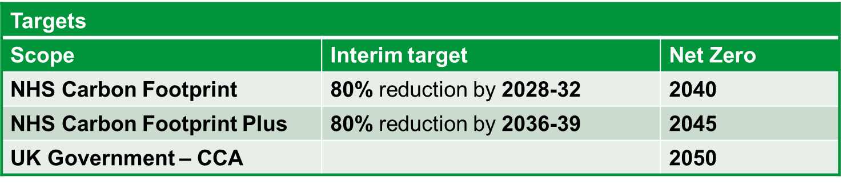
Delivering a Net Zero NHS
Notes:
Target 2045

Slide 6
Policy Context in UK
Reducing greenhouse gas emissions from MDI inhalers mentioned in UK Government’s sixth carbon budget.
2019 NHS England Long Term Plan proposed 50% reduction of carbon footprint from inhalers within 10 years
2021: Net-zero NHS: Reducing pMDI use is one of two clinical priority areas for NHSE Integrated Care Systems to focus on in 2021/22
Guidance: NICE patient decision aid. BTS Guidance. NHSE inhaler group.
Pharmacies: expected to inform patients about inhaler disposal. Inhaler technique checks.
2021 PCN Services Contract: Impact and Innovation Fund
  Only 25% of inhaler prescriptions should be aerosol (excluding salbutamol) by 2023/4
  Incentives for choosing lower carbon intensity propellants
  90% of patients on the asthma register should have an ICS prescribed and only 10% will continue to use >6 SABA inhalers/year by 2024/5
Summary courtesy of Aarti Bansal

Slide 7
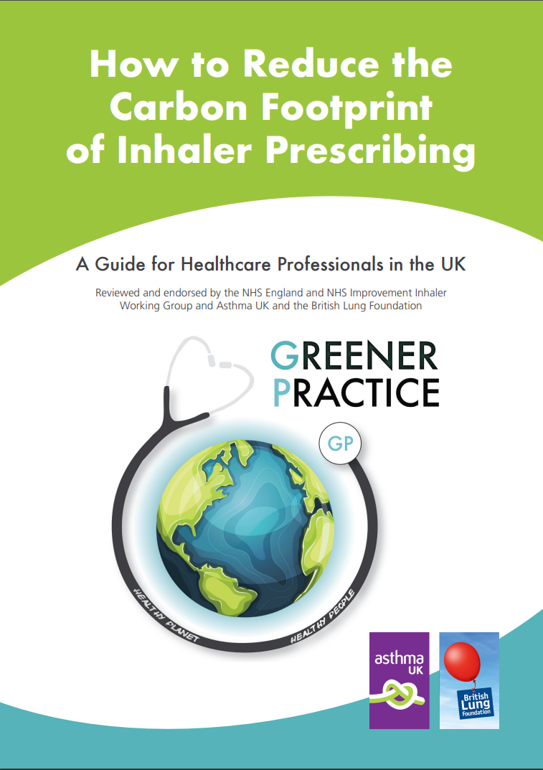
Helpful guidelines
“Prescribers, pharmacists and patients should be aware that there are significant differences in the global-warming potential of different MDIs and that inhalers with low global-warming potential should be used when they are likely to be equally effective.” BTS/Sign Asthma Guidelines (2019)
Download this PrescQIPP inhaler guide which outlines the global warming potential of different inhaler types.
Download this Greener Practice prescribing guide which has been endorsed by the BLF, Asthma UK and NHS England
Notes:
https://www.prescqipp.info/media/5719/295-inhaler-carbon-footprint-20.pdf
https://www.greenerpractice.co.uk/s/Reducing-Carbon-Footprint-of-Inhaler-Prescribing-v332.pdf
The current British Thoracic Society and Sign Asthma Guidelines are that inhalers with low global-warming potential should be used when they are likely to be equally effective.
This means we prioritise our patients health above everything else, but we should use inhalers with lower global-warming potential where appropriate.

Slide 8
Carbon footprint of inhalers
Inhalers are the largest single item contributing 3.1% of the carbon footprint of the NHS
This is equivalent to all the emissions from 184,858 passenger cars driving continuously for a year (EPA calculator 0.85 MtCO₂e)
The reason it is so big is because the propellant gases in aerosol inhalers (pMDI) are strong greenhouse gases
95% of the carbon footprint of aerosol pMDI inhalers is due to the propellant gas. Manufacture and disposal of the plastic/metal device make up <5%.
Dry powder inhalers (DPI) and soft mist inhalers (SMI) do not use propellant gas and have a ~25x lower carbon footprint per dose
Notes:
People often think of the carbon footprint of the NHS as relating to power consumption, heating and transport, but prescribing is actually its greatest component, and inhalers in particular are the largest single item contributing to the NHS’s carbon footprint.
Each 100 dose MDI inhaler has the carbon footprint of a drive from London to Sheffield, and as a whole, inhaler prescribing contributes the same as 200,000 cars driving continuously.
The reason is the propellant in MDI inhalers. Hydrofluorocarbons are a potent greenhouse gases. This gas is released into the atmosphere with each puff and are not part of the medicinal component, just the propellant. The metal or plastic parts only contribute about 5% of the carbon footprint.
Dry powder and soft mist inhalers do not use hydrofluorocarbons and have a roughly 25x lower carbon footprint per dose.

Slide 9
Patient-held inhalation devices
Dry powder (DPI)
Requires QUICK and DEEP inhalation (within 2-3 secs)
Aerosol (pMDI)
Requires SLOW and STEADY inhalation (over 3-5 secs)
Soft-mist (SMI)
Spacer
Chamber removes need for breath/actuation coordination
Facemask removes need for tight lip seal
Non HFC so better for the environment
Good for very young, very old, severe disease
Does not require spacer
Limited formulary (currently LABA/LAMA only)
Multi-dose solution for inhalation
Good for people with poor inspiratory flow
Does not require spacer or coordination
Breath actuated
Non-HFC ‘vape’ technology
Can be as effective as nebulisers in an acute attack
Either tidal breathing or single breath and hold
Requires breath/actuation coordination OR spacer OR breath actuated device
May not have dose counter
Good for people with normal inspiratory flow
Used with aerosol inhalers only
Contains HFC propellants
Notes:
A quick reminder

Slide 10
Common classes of inhaled drug
SABA
Short acting beta-agonist
ICS
Inhaled corticosteroid
LABA / LAMA
Long acting beta- agonist / muscarinic antagonists
Combination
Relieves acute breathlessness
Regular use => poor control?
Used regularly to reduce lung inflammation and acute flare ups
Symptom relief in moderate/severe COPD
ICS + LABA
Combined therapy for COPD and asthma not controlled by ICS + tablets alone
Notes:
A quick reminder

Slide 11
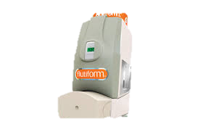
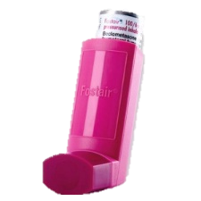
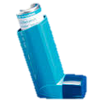
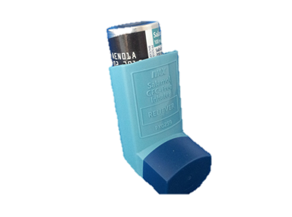
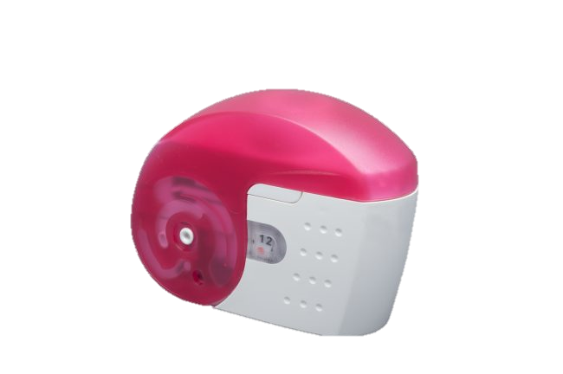
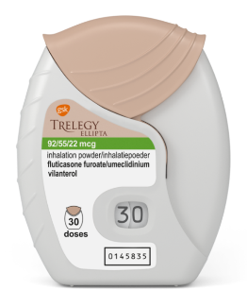
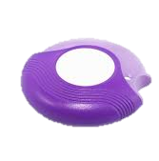
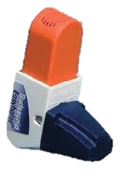
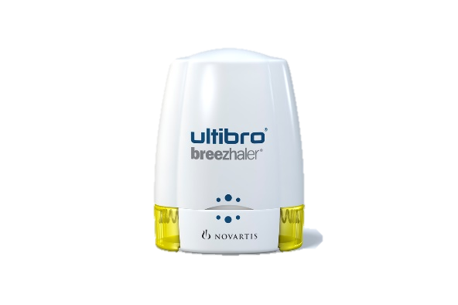
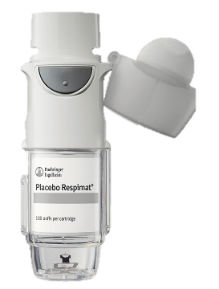
Carbon footprint of various inhalers in kg CO₂e per device or per month
Aerosol pMDI inhalers are
“high carbon” due to the propellant gas
Not yet available
Dry powder inhalers and soft mist inhalers are “low carbon” as they do not use propellant gases
If refilled
Janson C, Henderson R, Löfdahl M, et al Thorax 2020;75:82-84.
Notes:
“could do with more references, and also a caveat that different carbon-footprinting analyses were used, so direct comparisons are not perfectly comparable.“
Here are some refs: (!)
Thorax 2021;76:A189-A190.
Thorax 2020 ;Jan;75(1):82-84
BMJ Open Respiratory Research 2020;7:e000571
Advances in Therapy volume 36, pages2487–2492(2019)
Thorax 2020 ;Jan;75(1):82-84
BMJ Open 2019;9:e028763
Eur Respir J 2018;52:PA1021
BMJ Open Respiratory Research 2020;7:e000571
Sustainability 2021, 13(12), 6657; https://doi.org/10.3390/su13126657

Slide 12
UK has the highest aerosol pMDI inhaler use in Europe
Aerosol pMDI inhalers make up 70% inhalers used in UK, compared with <50% in rest of Europe, 10-30% in Scandinavia
Asthma mortality in the UK is one of the worst in Europe (Asthma UK, 2018)
Most European countries use dry powder inhalers preferentially to aerosol inhalers and have as good if not better asthma outcomes, although this is multifactorial.
Notes:
Most European countries use dry powder inhalers preferentially to metered dose inhalers and have as good if not better asthma outcomes.

Slide 13
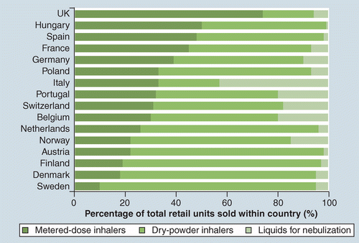
Inhaler device prescribing and asthma mortality
UK
Lavorini 2011 based on data from 2002-2008
WHO European Health Information Gateway
Notes:
It is very hard to argue that higher DPI use is associated with higher mortality.

Slide 14
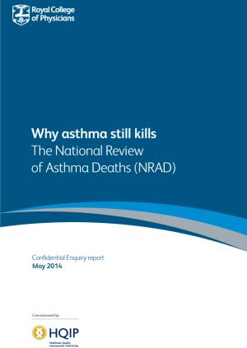
Why Asthma Still Kills: The National Review of Asthma Deaths (NRAD)
NRAD found widespread issues with the quality of asthma care amongst those who died, with several areas of key findings including:
excessive prescribing of reliever medication
under-prescribing of preventer medication
inappropriate prescribing of long-acting beta agonist (LABA) bronchodilator inhalers.

Slide 15
The majority of SABA prescribing for asthma in the UK is linked to over-reliance on reliever inhalers
25
20
of all SABA reliever prescribing for asthma in the UK goes to patients overusing their reliever
83%
15
Patients (%)
10
5
0
0
5
10
15
20
SABA canisters in baseline year
SABA overuse
Graph courtesy of Alex Wilkinson

Slide 16
How to address SABA (blue reliever inhaler) over-reliance
Search out and review as a priority patients with high SABA use
Review diagnosis – not all that wheezes is asthma.
  Consider secondary care referral if diagnostic uncertainty or disease control remains poor
Review treatment
  Explore attitudes to inhalers – 2/3 asthma patients in UK are not using their preventer inhaler regularly (Thorax 2021;76:A19)
  Explore attitudes to spacers – real world use is low
  Review inhaler technique – change inhaler if necessary, consider breath actuated/DPI if difficulty coordinating actuation with inhalation
  Escalate therapy according to guidelines
  Consider combined maintenance and reliever therapy (recommended in BTS, NICE and GINA guidelines, usually involves a DPI)
Notes:
Search out and review as a priority patients overusing SABA. Database searches for those using 6+ inhalers may be a good place to start. The mean number of SABAs used by patients overusing their SABAs is 6.5 per year. (Thorax 2021;76:A19.)
Review diagnosis – not all that wheezes is asthma.
Consider secondary care referral if diagnostic uncertainty or disease control remains poor
Other conditions such as upper airway dysfunction and dysfunctional breathing can mimic or worsen asthma, but don’t respond to inhaled therapies.
Review treatment
Inhaler technique
For most asthma patients on SABAs and ICS we have near universal use of MDIs, but many patients have better technique or would prefer to use a DPI. The most common, important inhaler errors are failing to inhale and actuate at the same time with an MDI, and failing to breathe in hard enough with a DPI.
Explore attitudes to inhalers
Does your patient understand that inhaled steroids are needed to control the disease, and that the blue inhaler is just for symptom control?
Escalate therapy according to guidelines
If patient is needed oral steroids to control their asthma then they should be referred to secondary care. Newer biologic therapies can be very effective for some patients with allergic or eosinophilic asthma.
Consider single inhaler maintenance and reliever therapy (recommended in BTS, NICE and GINA guidelines, usually involves a DPI)
This strategy has the potential to simplify therapy for the patient, improve disease control, reduce the risk of severe exacerbations, reduce overall steroid burden, and reduce carbon footprint. Most licensed MART inhalers are DPIs which have a far smaller carbon footprint than MDIs.
npj Primary Care Respiratory Medicine volume 30, Article number: 25 (2020)

Slide 17
Dry Powder vs Metered Dose Inhalers – real world asthma studies
Favours dry powder inhalers (DPI)
Switching patients from other inhaled corticosteroid devices to the Easyhaler®: Historical, matched-cohort study of real-life asthma patients. J Asthma Allergy 2014, 7: 31-51.
  n=1,958, preventer DPI vs pMDI
Effectiveness of fluticasone furoate plus vilanterol on asthma control in clinical practice: An open-label, parallel group, randomised controlled trial. Lancet 2017, 390: 2247-55.
  n=4,233 combination DPI vs usual care
Effectiveness of inhaler types for real-world asthma management: retrospective observational study using the GPRD Journal of Asthma and Allergy 2011:4 37–47
  n=50,000 preventer DPI vs pMDI
Favours aerosol inhalers (pMDI)
Device type and real-world effectiveness of asthma combination therapy: An observational study Respiratory Medicine 2011 10:1457-1466
  n=3,134 combination DPI vs pMDI
Randomised controlled trials repeatedly demonstrate no difference in the efficacy of aerosol pMDIs vs DPIs: ‘real world’ studies are equivocal, however the largest UK observational study (50,000 patients) favours DPI
Notes:
Randomised controlled trials repeatedly demonstrate no difference in efficacy between MDIs and DPIs, but in real-world use the patients we see are very different to the carefully selected, highly motivated patients in clinical trials, and it seems very likely in the real world that there will be differences in effectiveness between inhaler types.
This is by no means an exhaustive list, but for me these are the most significant real world asthma studies relevant to the UK demonstrating differences between MDIs and DPIs. The study on the right is a retrospective observational study comparing seretide evohaler and seretide accuhaler and those patients on evohaler MDI tended to do better. On the left first we have a matched cohort study of patients switched to DPI Easyhaler showing those patients had fewer exacerbations and better asthma control. Probably you’re all familiar with the salford lung study of once daily DPI asthma treatment vs usual care. This not only improved asthma control, it reduced over-reliance on reliever SABA inhalers and those randomised to the DPI had overall a 120kg lower carbon footprint. The final study is perhaps the biggest study using Gpreserach database looking at over 50,000 patients.

Slide 18

Offer a dry powder inhaler (DPI) where clinically appropriate
“The majority of asthma patients using pMDIs would change device for environmental reasons so long as the new inhaler was efficacious, easy to use and fitted their current routine, and that they could change back if needed.” Annex B of Primary Care Networks – plans for 2021/22 and 2022/23
If switching to a different inhaler type
  Discuss reasons for change
  Ask for and address any concerns
  Offer the option to change back if needed
  Teach inhaler technique, preferably using device-specific training videos (Asthma UK or Right Breathe)

Slide 19
Where aerosol pMDI inhalers are needed, consider less environmentally damaging options
Aerosol pMDI inhalers may still be needed for patients with low inspiratory flow rate, or who need a spacer (the “very young, very old or very sick”)
Consider a less damaging propellant
  HFA134a has lower GWP than HFA227ea (e.g. switch Flutiform to Fostair)
Consider a lower volume inhaler
  Smaller volume devices, require less propellant for the same dose (e.g. switch Ventolin to Salamol)
Consider reducing the number of actuations
  It may be possible to prescribe the therapeutic dose as a single puff, which halves the amount of propellant used (e.g. prescribe 1 puff of 200mcg Clenil twice a day rather than 2 puffs of 100mcg Clenil twice a day)
Consider an inhaler with a dose counter
  Knowing how many doses are left in a device helps to avoid both ineffective use of empty inhalers and unnecessary replacement of non-empty inhalers
Notes:
Where you have to use a Metered Dose Inhaler, for example because the do not have the inspiratory power for dry powder dispersion, or the patient needs a spacer with a face mask, or the drug they need is not available as a soft mist inhaler. We suggest the following protocol.
Firstly check the propellant to see if the same drug can be delivered with a lower global warming potential. There are new propellants coming onto the market with greatly reduced global warming potential, for example HFA152a.
Next check whether you could prescribe a device that uses a lower volume of propellant, e.g. Salamol
Next, check whether you could prescribe a single puff instead of two, especially if the patient is willing and able to use a spacer.
Finally, see if you can prescribe a device with a dose counter. This ensures that patients aren’t at risk of continuing to use an empty inhaler, as well as ensuring they aren’t throwing inhalers away while they are still full.

Slide 20

The potential environmental impacts of different aerosol pMDI inhaler options
Flutiform (higher GWP propellant HFA227ea)
Fostair (lower GWP propellant HFA134a)
Salamol salbutamol inhaler (lower propellant volume)
Ventolin salbutamol inhaler (higher propellant volume)
1 device = 370 km in a Ford Fiesta
1 device = 114-143 km
1 device = 100 km
1 device = 282 km
“Where there is no alternative to MDIs, lower volume HFA134a inhalers should be used in preference to large volume or HFA227ea inhalers.” BTS/Sign Asthma Guidelines (2019)

Slide 21
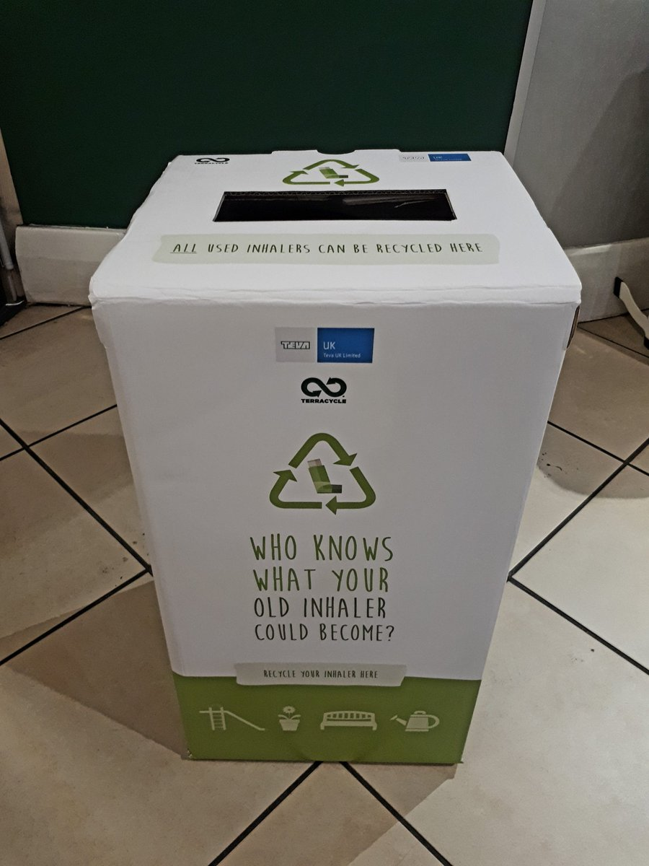
Recycling vs incineration vs domestic waste
“Patients should be encouraged to ask the pharmacy they use if they can recycle their used inhalers.” BTS/Sign Asthma Guidelines (2019)
Currently, no national inhaler recycling scheme
Individual CCGs, however, are setting up schemes (check locally)
Notes:
BTS/Sign Asthma Guidelines recommend that patients return old inhalers to their pharmacy, to be recycled or incinerated. Inhalers can be disposed of by the pharmacist with other drugs waste, this is then thermally treated to destroy the greenhouse gases. This environmentally safe disposal route is available at all pharmacies and is paid for by NHS England.

Slide 22
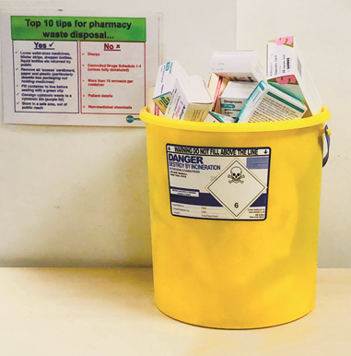
Incineration is still better than domestic waste
When aerosol inhalers are disposed of as domestic waste, the residual propellant gas escapes and causes global warming.
From 2019, all inhaler devices should be returned to pharmacies to be disposed of as medicines waste. This means that they are incinerated at high temperatures, destroying the propellant and reducing the climate change impact.
This environmentally safer disposal route is available at all pharmacies and is paid for by NHS England.
Notes:
Change picture to safe disposal.
If inhalers are simply disposed of in domestic waste, the left over gases contribute to global warming. If they are returned to the pharmacist for incineration, this destroys the propellant reducing the climate change impact. All NHS pharmacies are contracted to dispose of inhalers in this way.
Some pharmacies also offer recycling facilities, although currently this is still a minority. There are online directories of pharmacies that offer this service.

Slide 23
The carbon footprint of respiratory care can be improved in many additional ways
Sustainable healthcare whilst improving respiratory care
Reduce the amount of healthcare needed
Improve the efficiency of healthcare
Prevention
Aim
Primary drivers
Secondary drivers
Patient education / empowerment
Lean effective pathways
Lower impact swaps
Operational resource use
Potential actions
Vaccination uptake, smoking cessation quit rates
Pulmonary rehabilitation / inhaler technique and adherence / personal care plans
Integrated care planning, respiratory nurse community outreach, rescue packs
Low dose / HFC-free inhalers, DPI prescribing, inhaler recycling, spacers
Access to telehealth, appointment reminders, electronic prescribing
Mortimer F, 2010 Clinical Medicine
Notes:
Don’t forget the carbon footprint of respiratory care can be reduced in many ways. This driver diagram, shows that we can reduce the carbon footprint either by reducing the amount of respiratory care that is needed, or by providing the same volume of care, but in a less carbon intensive way.
Less activity can be achieved by
1) prevention, for example smoking cessation; or reduced air pollution
2) patient enablement, for example through improved inhaler technique or pulmonary rehabilitation
3) Lean efficient pathways, for example integrated care planning or the provision of rescue packs (correct diagnosis ADD)
4) Lower impact swaps, such as dry powder inhalers
5) Better operational resource usage, such as dose counters, appointment reminders or electronic repeat prescriptions.

Slide 24
What might these changes achieve?
Strategy | CO2 saving / inhaler
Switch from aerosol pMDI to non-propellant inhaler | 8-36kg
Change from large volume pMDI reliever (Ventolin) to small (Salamol) | 18kg
Change from HFA227ea inhaler (Flutiform) to HFA134a inhaler (Fostair) | 20kg
Incinerate/recycle used pMDIs | 4-18kg
There were approximately 26 million pMDI inhalers prescribed in 2016-17 (BMJ 2019;365:l4135)
If the strategies on the right were adopted, and saved an average of 20kg CO₂ per inhaler, this would be equivalent to savings of 520,000,000 kg CO₂ per year
This would be equivalent to 5.2 billion km less driven in a Ford Fiesta, per year
Table courtesy of Alex Wilkinson

Slide 25
Take-home messages
Better care,
greener care
Right diagnosis
Right drug
Right device
Right disposal

Slide 26
Session outline
Presentation
Dr Frances Mortimer
Consolidation
Dr Kay Leedham-Green
Optimising respiratory care
Self-test quiz
Q&A
Case studies
Discussion
Inhalers and the environment
Dr Aarti Bansal will address your questions (keep them coming in the chat!)

Slide 27
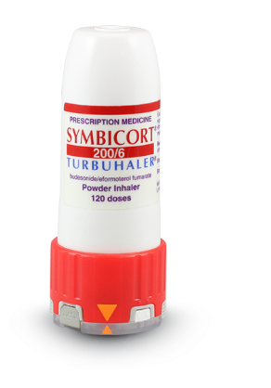
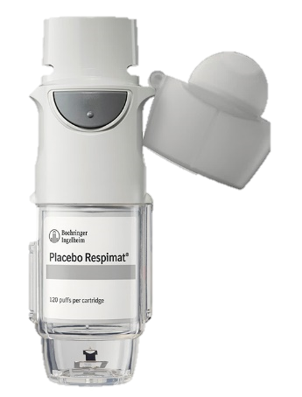
Self-test quiz
Which of these types of inhaler has the highest global warming potential?
Answer: aerosol
A) aerosol
B) dry powder
C) soft mist

Slide 28
Self-test quiz
We will discuss each of these cases after the quiz…
Ms A, a 16 year-old student, wants to reduce the environmental impact of her inhalers. She takes 4 puffs of preventer daily, and typically needs 2 puffs of reliever each week (both HFA134a aerosol high volume inhalers). She has strong inspiratory flow but requires an aerosol pMDI reliever inhaler for school. Which option would optimise her care whilst minimising environmental impacts?
Answer: A) Switch her preventer inhaler to a dry powder inhaler (DPI)
Rationale: DPI inhalers are suitable for patients with strong inspiratory flow; a lower volume device could halve the environmental impact but a DPI would reduce it by a factor of approximately 20; Ms A could also return her inhalers to the pharmacist and switch to a low volume reliever.
A) Switch her preventer inhaler to a dry powder inhaler
B) Switch her reliever inhaler to a lower volume aerosol pMDI device
C) Switch her preventer inhaler to a lower volume aerosol pMDI device
D) Return her used inhalers to the pharmacist

Slide 29
Self-test quiz
We will discuss each of these cases after the quiz…
Mr B, aged 79, has dementia and moderate COPD with reduced inspiratory flow. He lives in a care home and is supported with a Fostair (combination LABA+ICS HFA134a aerosol pMDI) inhaler with spacer, 2 puffs daily. Which option would optimise his care whilst minimising environmental impacts?
Answer: D) Return his used inhalers to the pharmacist
Rationale: DPI inhalers are not suitable for patients with reduced inspiratory flow; 1 puff is below the BNF recommended therapeutic dose for Fostair; HFA227ea inhalers are more environmentally damaging than HFA134a inhalers
A) Switch to a dry powder inhaler (DPI)
B) Reduce his inhaler therapy to 1 puff daily
C) Switch to an HFA227ea aerosol pMDI inhaler
D) Return his used inhalers to the pharmacist

Slide 30
Self-test quiz
We will discuss each of these cases after the quiz…
Mrs C, a 34y security officer, has had several admissions with acute asthma but continues to use her reliever inhaler more than her preventer inhaler as she keeps irregular hours and often forgets. She doesn’t use a spacer despite poor breath-actuation coordination as this is inconvenient for her work. Which option would optimise her care whilst minimising environmental impacts?
Answer: D) Prescribe a combined preventer and reliever DPI inhaler
Rationale: A and B do not address her preventer adherence; all DPI inhalers are breath actuated so these are more likely to overcome her issues with coordination whilst minimising environmental impacts.
A) Switch both her inhalers to DPI
B) Switch her preventer inhaler to a breath actuated inhaler (BAI)
C) Switch to a combined aerosol pMDI preventer and reliever
D) Switch to a combined preventer and reliever dry powder DPI inhaler

Slide 31
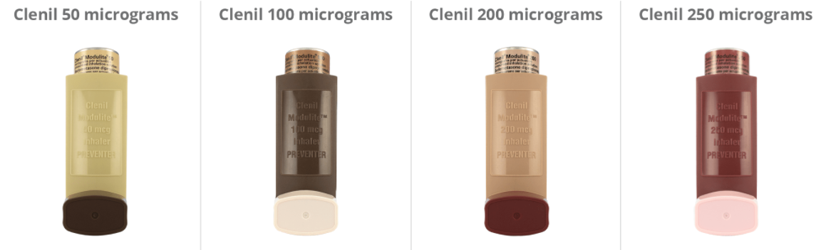
Self-test quiz
We will discuss each of these cases after the quiz…
Mr D’s son is 6 years old and used to feel wheezy most evenings. He is now well controlled on 100mcg beclomethasone twice per day and a SABA as required. He requires an aerosol pMDI with spacer. Which option would optimise his care whilst minimising environmental impacts?
Ans: B) 100mcg 1 puff
twice/day
Rationale: right dose,
right interval, lowest
HFC release
A) 50mcg 2 puffs twice/day
B) 100mcg 1 puff twice/day
C) 200mcg 1 puff once/day
D) 250mcg 1 puff once/day

Slide 32
Activity
In threes or fours, role play (or discuss) the scenarios from the above quiz. Take turns to be the clinician, the patient/carer or observer (s).
Clinician: practise finding the right words, guidelines, information +/- training videos to counsel your patient/carer.
Patient/carer: what concerns might this person have? Did the explanations you received make sense to you? Did the consultation feel person-centred?
Observer(s): are the correct guidelines being followed? Did the consultation appear person-centred? Was the safety-netting adequate?
Ms A – practise finding and using the correct training video for an Easyhaler beclometasone DPI inhaler and safety netting the change for a teenaged student.
Mr B – who would you need to talk to about returning Mr B’s inhalers to the pharmacy? Find out if there is a recycling scheme in your area, if not how would you explain the importance of returning to pharmacy for incineration?
Mrs C – practise shared decision-making over each of Mrs C’s potential options, personalising your approach to her needs as a security officer. Safety-net and find a training video for a combined Spiromax DPI inhaler.
Mr D – can you find out how many doses there are in a Clenil 100 mcg per dose inhaler? Explain to Mr D how long each inhaler should last if his son takes 1 puff twice/day.

Slide 33
Case study A: switching safely
Ms A, a 16 year-old student, wants to reduce the environmental impact of her inhalers. She takes 4 puffs of preventer daily, and typically needs 2 puffs of reliever each week (both HFA134a aerosol high volume inhalers). She has strong inspiratory flow but requires an aerosol pMDI reliever inhaler for school.
Ms A has agreed to
switch her preventer inhaler to an Easyhaler dry powder inhaler (DPI);
change her aerosol pMDI inhaler from Ventolin to lower volume Salamol inhaler
return her inhalers to the pharmacist for incineration
Practise finding and using the correct training video for an Easyhaler beclometasone DPI inhaler (post link in chat!)
  Right Breathe
  Asthma UK
How might you safety net these changes for a teenaged student?
  Implications of more than one inhaler type?
Share your thoughts on challenges / helpful strategies.

Slide 34
Case study B: returning/recycling
Mr B, aged 79, has dementia and moderate COPD with reduced inspiratory flow. He lives in a care home and is supported with a Fostair (combination LABA+ICS HFA134a aerosol pMDI) inhaler with spacer, 2 puffs daily.
The main option to reduce the carbon footprint of Mr B’s care is to return his inhalers for recycling / incineration.
Who would you need to talk to about returning Mr B’s inhalers to the pharmacy?
Find out if there is a recycling scheme in your area (post the link)
How would you explain the importance of returning inhalers to the pharmacy? How could you make this easier for the care home?
Share your thoughts on challenges / helpful strategies.

Slide 35
Case study C: personalisation
Mrs C, a 34y security officer, has had several admissions with acute asthma but continues to use her reliever inhaler more than her preventer inhaler as she keeps irregular hours and often forgets. She doesn’t use a spacer despite poor breath-actuation coordination as this is inconvenient for her work.
You want to discuss switching to a combined preventer and reliever DPI inhaler (MART)
In what ways is this approach personalised to her needs?
  As a security officer with irregular hours and no space for a spacer
  As a person who has poor breath actuation coordination
  As a person with low adherence to maintenance therapy
What words could you use to explain/negotiate the switch?
How might you safety-net?
Can you find a training video for a combined Spiromax DPI inhaler? (post link in chat)
Share your thoughts on challenges / helpful strategies.

Slide 36
Case study D: optimising pMDI usage
Mr D’s son is 6 years old and used to feel wheezy most evenings. He is now well controlled on 100mcg beclomethasone twice per day and now seldom needs his SABA reliever.
His son requires an aerosol pMDI with spacer.
You want to discuss prescribing one puff (100mcg/puff) vs two puffs (50mcg/puff) for his maintenance ICS preventer therapy.
Can you find out how many doses there are in a Clenil 100 mcg per dose inhaler?
How long should each inhaler last if Mr D’s son son takes 1 puff twice/day.
Share your thoughts on challenges / helpful strategies
How might you monitor adherence to the new dosing regimen?

Slide 37
Discussion
How is better greener inhaler prescribing being addressed in your area, for your patients?
  Current strategies
  Future strategies
Any other concerns / challenges / strategies?

Slide 38


