Slide 2
Greener Inhalers

Slide 7
Optimise prescribing
Get or maintain
Get or maintain good control of asthma and COPD through reviewing patients regularly and treating in line with NICE asthma and COPD treatment pathways
Agree
Agree local respiratory pathways and medicines formulary choices which take into account inhaler carbon footprints
Improve
Improve inhaler technique
Reduce
Reduce short acting beta agonist (SABA) overuse
Use
Use combination inhalers

Slide 8
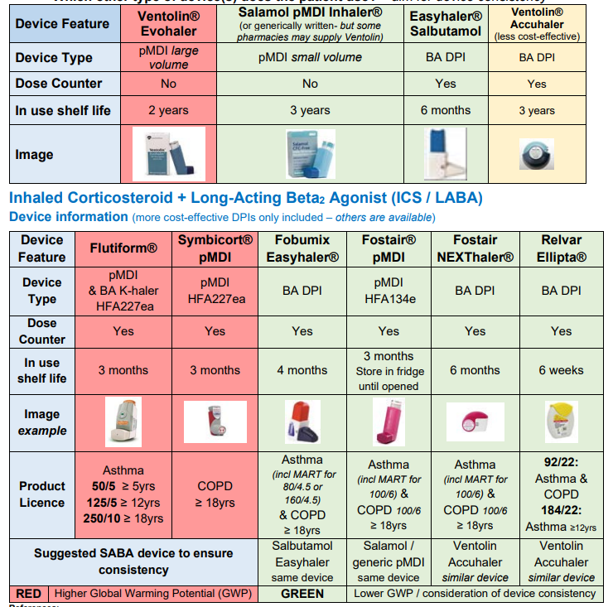
Suggested switches
Change Ventolin to salbutamol mdi (or Easyhaler)
If Flutiform patient can’t be changed to DPI then change to either Sereflo or Airflusal (lower GWP (and cost)) MDI
Flutiform has a net carbon footprint per 28 days of 33kg CO2 equivalent
Easyhaler has a net carbon footprint per 28 days of 226 grammes but is ‘certified net carbon neutral’
https://nww.knowledgeanglia.nhs.uk/LinkClick.aspx?fileticket=hYVuMlrZc4Q%3d&tabid=1971&portalid=1&mid=2027

Slide 9
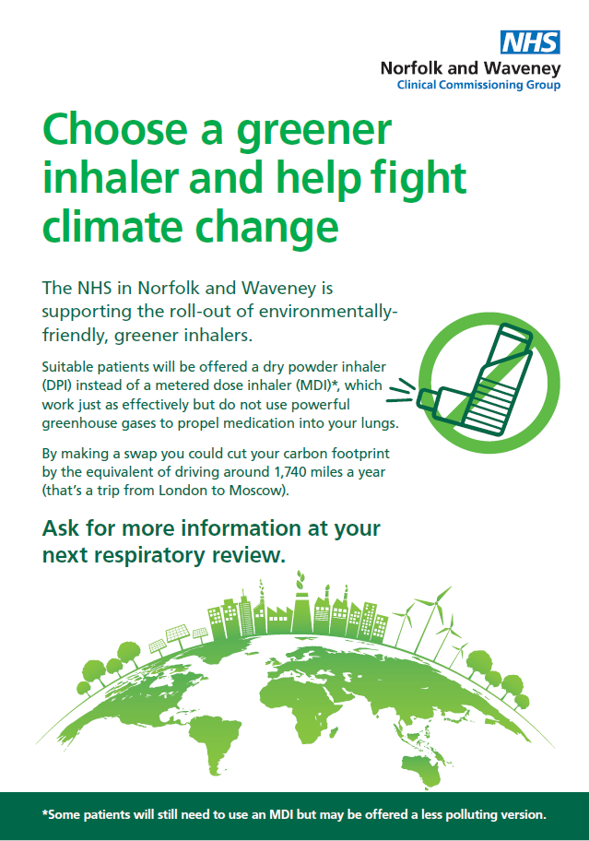
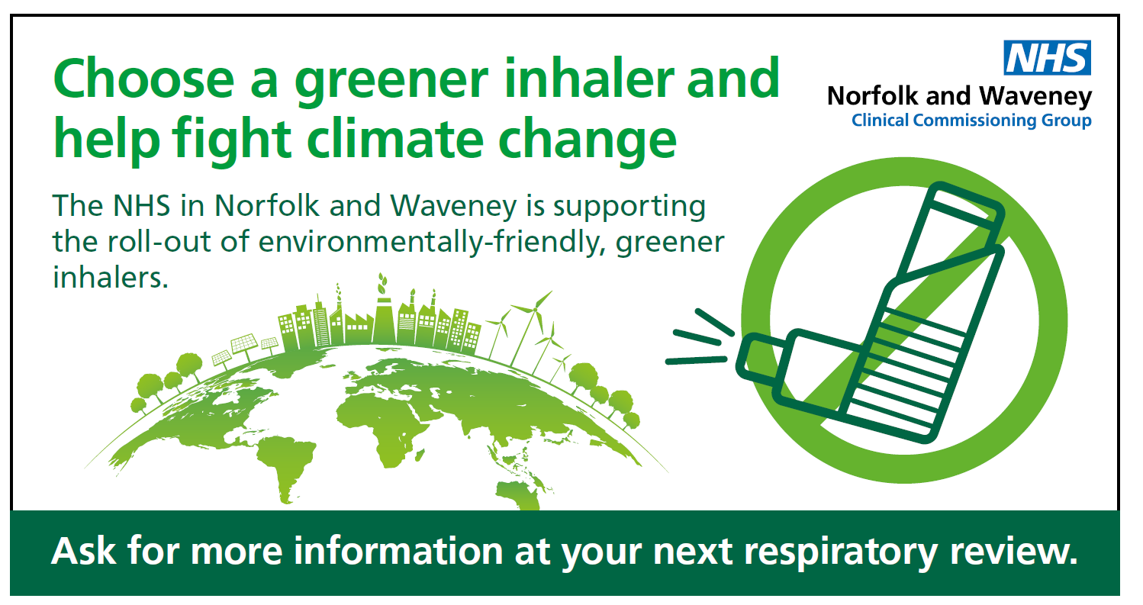
Public engagement

Slide 10
New Medicines Service (NMS)
The service provides support for people with long-term conditions newly prescribed a medicine to help improve medicines adherence; it is focused on particular conditions including respiratory.
Three patient contacts
At point of first dispensing
7-14 days after starting new medication (intervention stage)
14 - 21 days after second contact (follow up)

